Slide 1
Public Sector Economics
Taxes and Market Distortions – Theory

Slide 2
Main Lessons
rational foundations of policy distortions
how policy distortions are a result of “incomplete markets”
why labor supply is so important
tax equivalencies
wealth vs. substitution effect of a tax
rigorous definition of deadweight cost
the “taxable income elasticity”
measuring marginal tax rates
public policy needs market analysis
applications of the results to other economics fields

Slide 3
Rational Foundations
Olson’s Logic of Collective Action
  people do not voluntarily and unilaterally pay taxes (in the amount they are forced to pay) or otherwise contribute to collective goods, even if they appreciate the way tax revenues are used, because they rely on others to make the contribution
  restaurant example
  is this logic correct?
    in large groups?
    how else can tax distortions be explained?
tax payments vs. user fees
  eg., Feldstein-Samwick on SS “contributions”
  mandatory employee benefits
voluntary contributions
“excessive” tax compliance, “insufficient” take-up

Slide 4
Rational Foundations
Olson’s Logic of Collective Action
  people do not voluntarily and unilaterally pay taxes (in the amount they are forced to pay) or otherwise contribute to collective goods, even if they appreciate the way tax revenues are used, because they rely on others to make the contribution
  restaurant example
  is this logic correct?
    in large groups?
    how else can tax distortions be explained?
tax payments vs. user fees
  eg., Feldstein-Samwick on SS “contributions”
  mandatory employee benefits
voluntary contributions
  what is their motivation? how fast are they “crowded out?”
  might business taxes be more distortionary?
“excessive” tax compliance, “insufficient” take-up

Slide 5
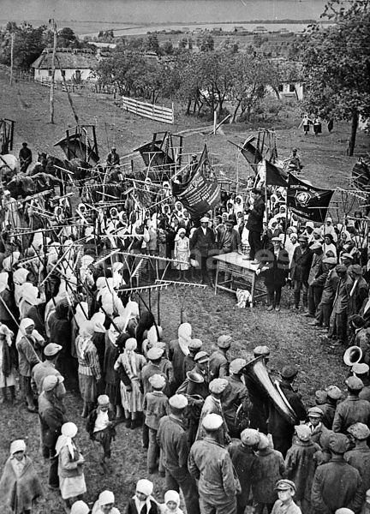
Soviet Collective Farms
Marxism-Leninism insisted that small-scale production in agriculture was
“uneconomic, conducive to low productivity and absorbing too much of the labor force of the country.”
Dolot, Miron (2011)
Image credit: http://www.eonimages.com/media/5c62b78c-3e50-11e0-b603-41195133e60e-harvesting-meeting-on-ukrainian-collective-farm
No U.S. copyright applies.
Notes:
The leadership claimed that small farms were not productive.

Slide 6
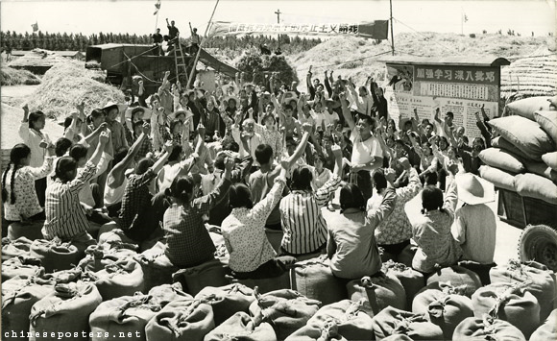
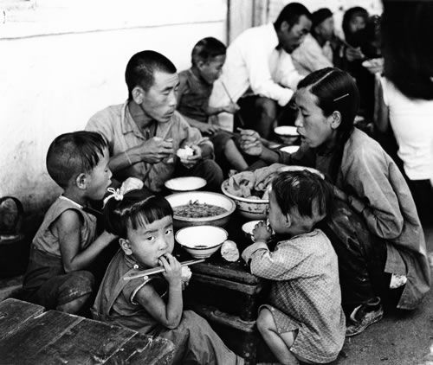
Chinese Communes
Mao Zedong on
communes:
“Their advantage is in combining industry, agriculture, commerce, education, and the military for more convenient management.”
Jisheng (2012)
Mao Zedong touts
“the superiority of large cooperatives”
Image credit: http://chineseposters.net/photographs/a62-938.php
Image credit: http://iftf.typepad.com/photos/uncategorized/great_leap_forward.jpg

Slide 7
Soviet Collective Farms
“…the land was no longer theirs. They could work that land, but there was no guarantee that they could harvest the crop.”
Dolot, Miron (2011)
Image credit: http://www.eonimages.com/media/5c62b78c-3e50-11e0-b603-41195133e60e-harvesting-meeting-on-ukrainian-collective-farm
No U.S. copyright applies.
Notes:
The leadership claimed that small farms were not productive.

Slide 8
Chinese Communes
“the state monopoly stifled incentives for increasing production…
deprived peasants of their right to obtain food and made them dependent on the government for every meal, while punishing them for applying individual effort in food production.”
Jisheng (2012)
Image credit: http://chineseposters.net/photographs/a62-938.php
Image credit: http://iftf.typepad.com/photos/uncategorized/great_leap_forward.jpg

Slide 9
Soviet Collective Farms
“the Soviet economy is proof that, contrary to what many skeptics had earlier believed, a socialist command economy can function and even thrive.”
Paul Samuelson and William Nordhaus (1989!)
Image credit: http://www.eonimages.com/media/5c62b78c-3e50-11e0-b603-41195133e60e-harvesting-meeting-on-ukrainian-collective-farm
No U.S. copyright applies.
Notes:
Quoted by http://online.wsj.com/articles/SB10001424052748704869304574595823818190240

Slide 10
Soviet Collective Farms
“[surprised:] Private allotments of land on the collective farm often have much higher, not lower productivity than the collectivized sectors.”
Paul Samuelson (1976)
Image credit: http://www.eonimages.com/media/5c62b78c-3e50-11e0-b603-41195133e60e-harvesting-meeting-on-ukrainian-collective-farm
No U.S. copyright applies.
Notes:
Quoted by Levy and Peart 2011

Slide 11
Soviet Collectivization
“That is why buildings in the Soviet Union – like public housing in the United States – look decrepit within a year or two of their construction.”
Milton and Rose Friedman (1980)
Image credit: http://www.eonimages.com/media/5c62b78c-3e50-11e0-b603-41195133e60e-harvesting-meeting-on-ukrainian-collective-farm
No U.S. copyright applies.
Notes:
Free to Choose (p. 24 of the 1990 edition)

Slide 12
The Virtues of Collective Ownership
E.g., journalists on single-payer health care
  Europeans have healthcare payroll taxes withheld from pay
  Americans have insurance premiums withheld from pay
  Supposedly no difference (per $ withheld)
Notes:
http://www.vox.com/2014/12/22/7427117/single-payer-vermont-shumlin
http://www.brookings.edu/views/papers/orszag/200504security.pdf

Slide 13
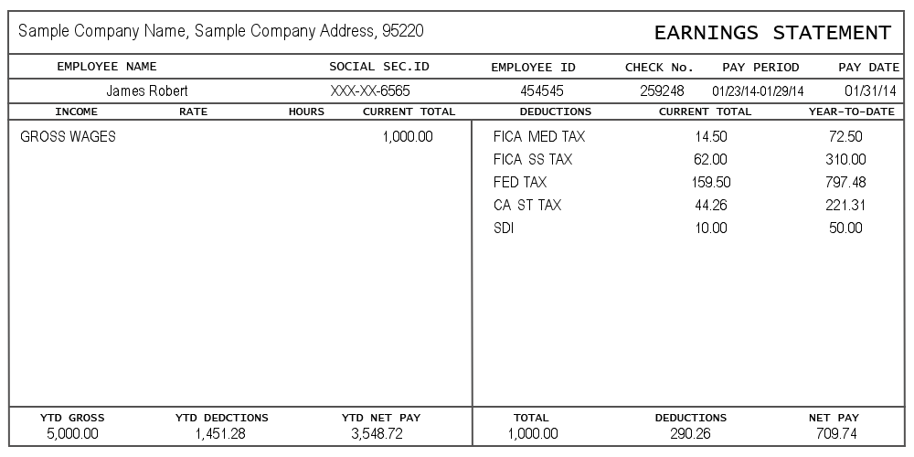
1,100.00
BCBS FAMILY PREMIUM
110.00
549.99
5,500.00
1,951.28
1,100.00
390.26

Slide 14
1,100.00
National HI Tax
110.00
549.99
Roberts family NHI benefits are independent of what (if anything) James pays
5,500.00
1,951.28
1,100.00
390.26

Slide 15
1,100.00
BCBS family premium
110.00
549.99
Roberts family gets BCBS benefits ONLY if James pays in full
5,500.00
1,951.28
1,100.00
390.26

Slide 16
The Virtues of Collective Ownership
E.g., journalists on single-payer health care
  Europeans have healthcare payroll taxes withheld from pay
  Americans have insurance premiums withheld from pay
  Supposedly no difference (per $ withheld)
Public ownership is simpler/less costly
  U.S. physicians annual spend $61k more (than Canadian docs) dealing with insurance companies
  See also Peter Diamond on the administrative costs of retirement accounts: SSA has proportionally less admin cost
Government’s large scale permits it to invest more in each decision and share the resulting wisdom
Government gets a bulk discount → more people served
Only real costs of public ownership: government faced with “difficult decisions”
These arguments work for most industries: health, education, groceries, airlines, housing, banking
Notes:
http://www.vox.com/2014/12/22/7427117/single-payer-vermont-shumlin
http://www.brookings.edu/views/papers/orszag/200504security.pdf

Slide 18
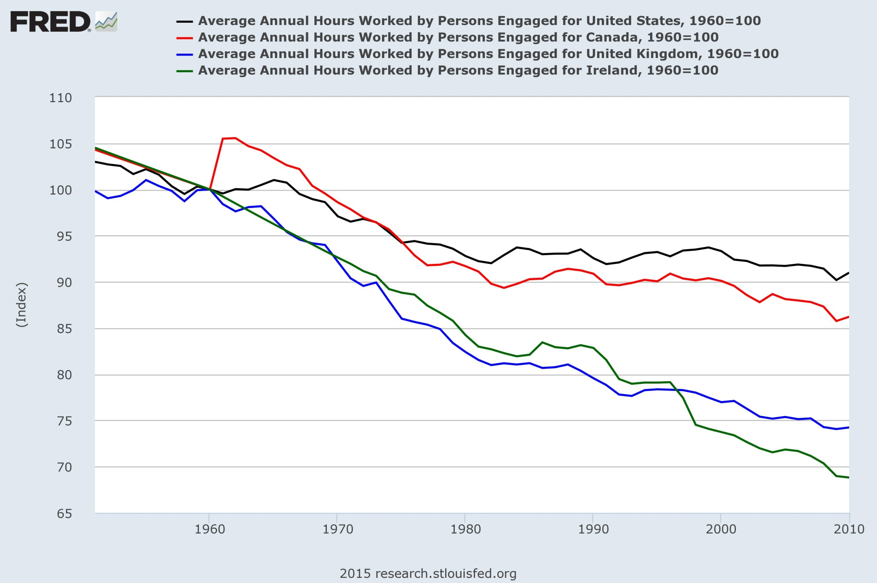

Slide 19
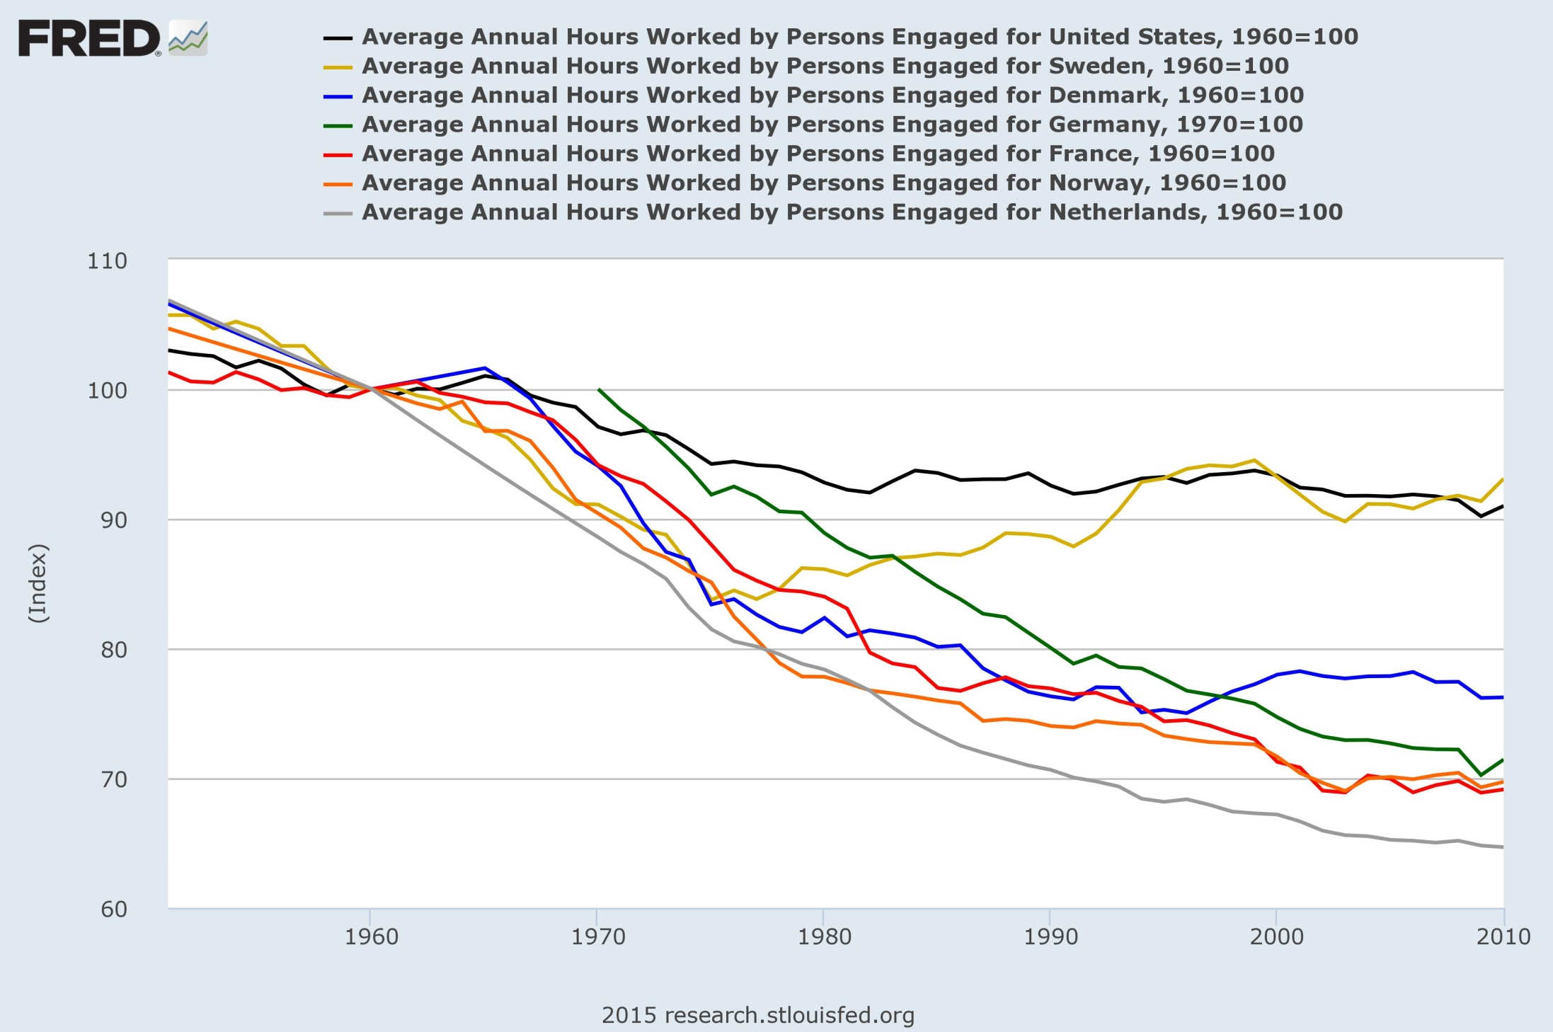
Notes:
http://www.businessinsider.com/average-annual-hours-worked-for-americans-vs-the-rest-of-the-world-2013-8

Slide 20
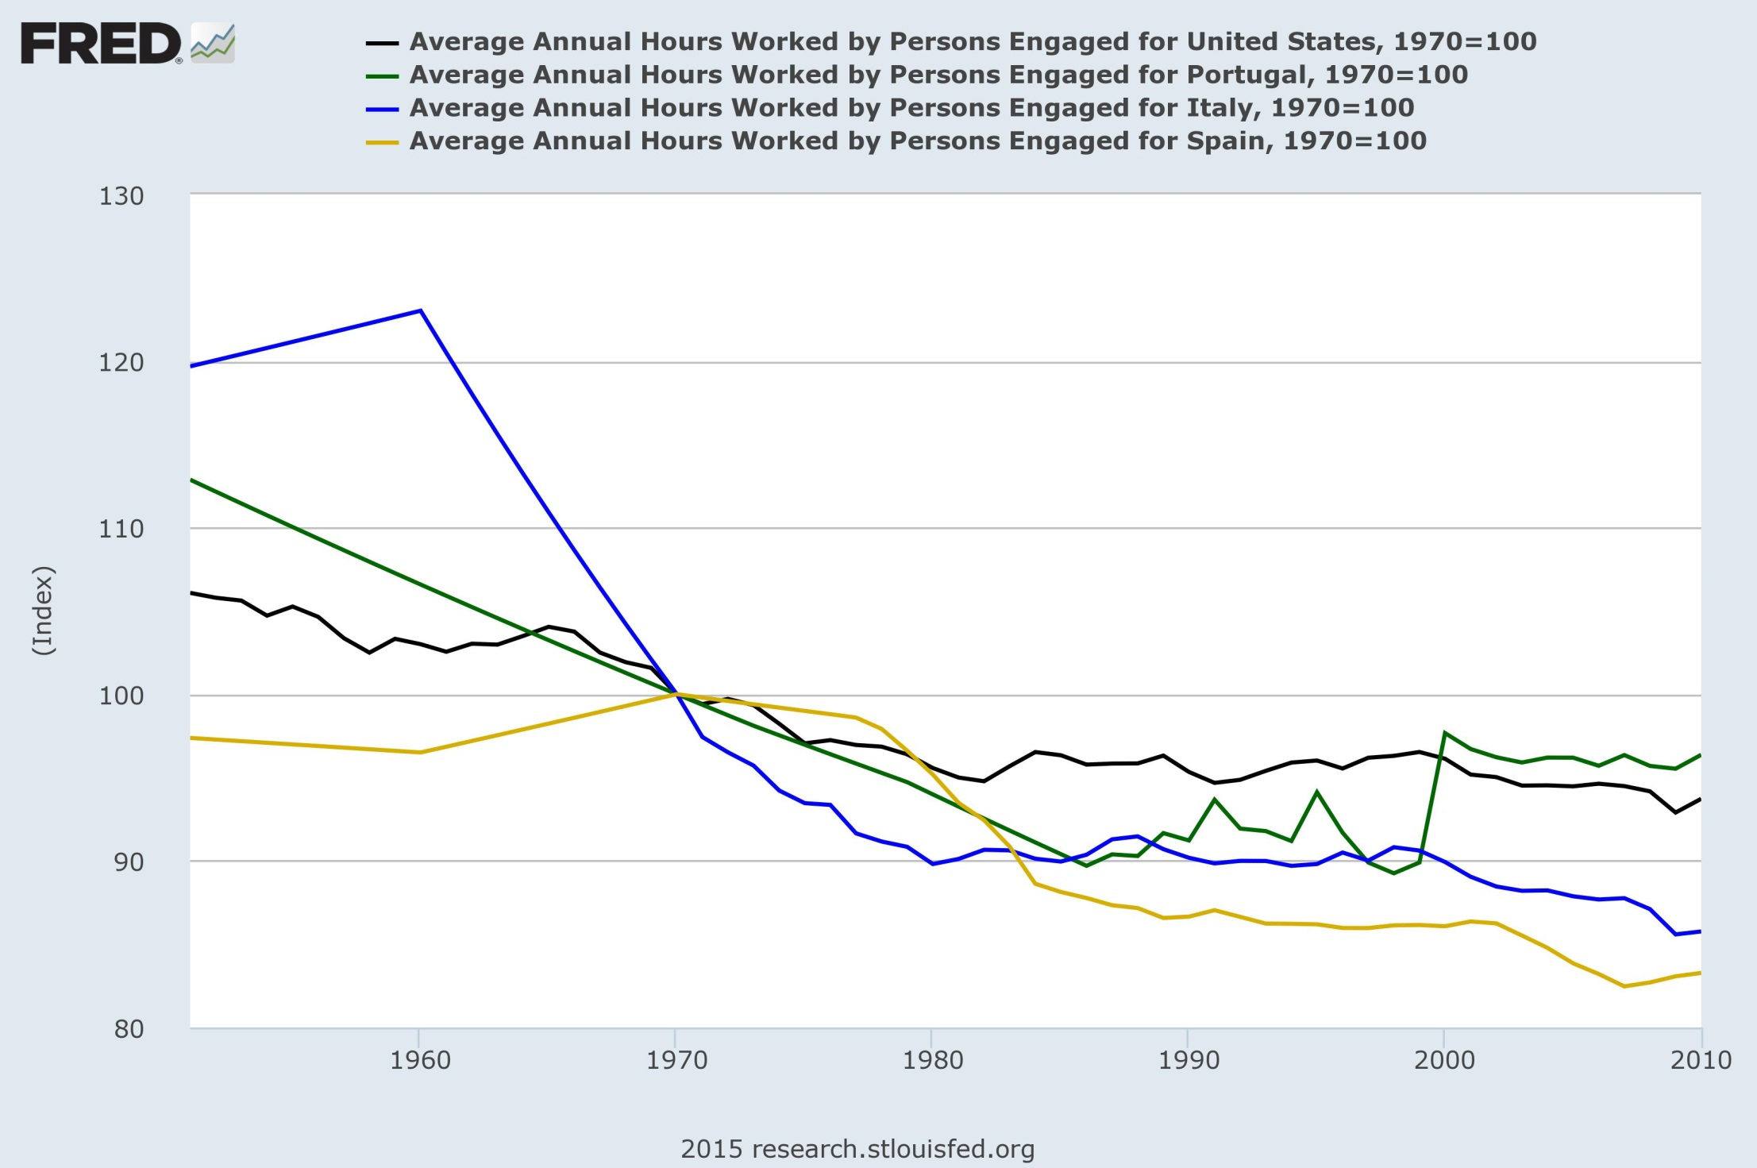

Slide 21
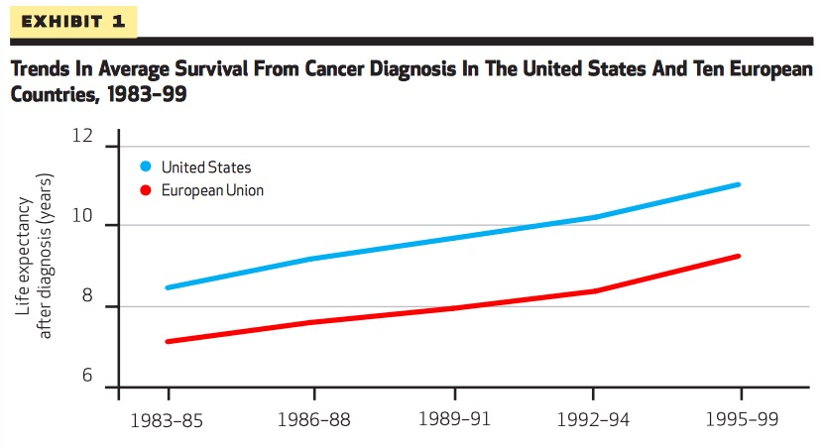
Source: Philipson, et al., Health Affairs 2012.

Slide 22
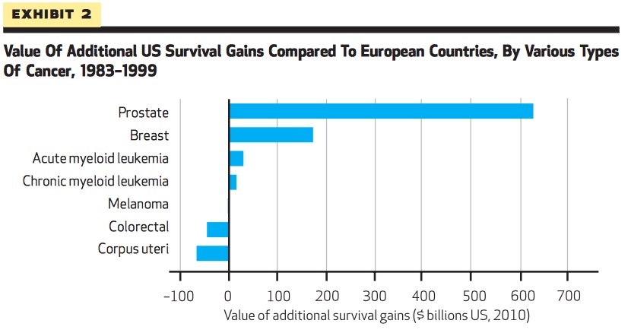
Source: Philipson, et al., Health Affairs 2012.

Slide 23
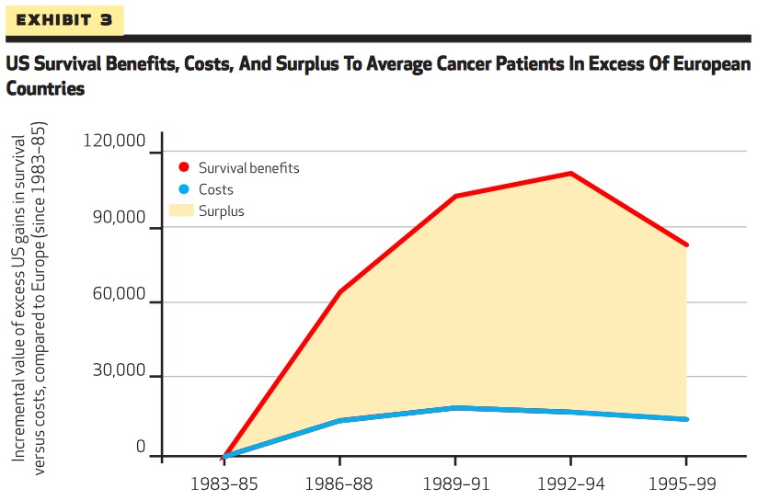
Source: Philipson, et al., Health Affairs 2012.

Slide 24
Rational Foundations (cont’d)
How complete are markets in Public Finance?
complete enough that:
  profits are zero
  goods (factor) prices equal marginal cost (product)
not so complete that there are contracts on untaxed goods (otherwise lump sum taxation is possible)
[not a complete set of policy contingent claims]
insufficient substitutes for complete markets. eg,
  altruism
  voluntary provision

Slide 25
Labor Tax Conversion Factors
Wealth vs. Substitution Effects

Slide 26
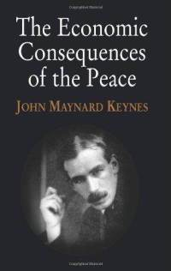

Slide 27


Slide 28




c
slope $=w$
slope $=\left(1−τ\right)w$
$$ν+f\left(n\right)−wn$$
$$f\left(n\right)−wn$$
0
n

Slide 29
c
dg
dg
0
n
substitution effect
wealth effect
combined effect

Slide 30
c
dg
dg
0
n
substitution effect
wealth effect
combined effect

Slide 35
Employment vs Earnings Tests
benefit amount
b₀
earnings-tested benefit
(magnitude of) slope = “benefit reduction rate”
employment-tested benefit
beneficiary earnings
0

Slide 36
Variations on the Employment Test
benefit amount
b₀
employment-tested benefit
beneficiary earnings
0

Slide 37
Budget Set Induced by Income Taxes/Benefit Phaseouts
The horizontal axis measures beneficiary income, from highest to lowest.
The black segment is the budget set without taxes and benefits.
all other goods
Tax paid/benefit foregone
MTR = 0%
MTR = 0%
MTR = 50%
MTR = 100%
MTR = 150%
Slope = -1
b
-1*(wage income)
-1*(full income)

Slide 38
Nonlinear Budget Constraints
Instances of Nonlinear Taxation
deductions
employment-related tax breaks
  tax exempt savings
  health expenditures
  consumption at work, fringes
tax evasion
EITC [Earned Income Tax Credit]
“progressivity”
[continuous and kinked versions]
“compliance costs”
effort

Slide 39
first 30 are exempt

Slide 40
Deadweight Loss
also known as deadweight cost, excess burden
5 definitions
  effect of policy on indirect utility (measured in “utils”)
  area under the Marshallian demand curve (measured in $)
  area under the Hicksian demand curve
  additional income required to achieve old (pre-policy) utility at new prices
  income change required to achieve new utility at old (pre-policy) prices
equivalence results
the “taxable income elasticity”

Slide 41
Nontaxed Activity as a Composite Good
tax avoidance can occur on many margins
  hours per week
  weeks per year
  work or not work
  cheat or not cheat
  occupational choice
  compensation composition
  …
taxable income elasticity as a summary statistic

Slide 42
Market Analysis

Slide 43
Measuring “the Marginal Tax Rate”
MTR = statutory tax rate?
  on a particular margin – substitution between tax base and untaxed activities
  “tax base” may be of limited interest economically. eg.,
    model may be about “capital,” but only some capital income is taxable
    model about “cigarettes,” but there are legal and illegal cigarette sales
MTR = average tax rate?
  “progressivity”
  marginal vs. average substitution

