Slide 1
Price Floors and Ceilings
Public Sector Economics
Notes:
1

Slide 2
Price Regulation: Examples
Rent control (ceiling)
Minimum wage (floor)
College athletes work without cash comp (ceiling)
Biblical prohibitions of usury (ceiling)
Organ donation (ceiling)
Salary caps for bank executives (ceiling)
Federal limits on payments to physicians (ceiling)
Farm price supports (floor)
Military pay (ceiling)
Food prices (ceiling)
Notes:
Minimum wage includes tenure, prohibitions of mandatory retirement

Slide 3
Price Regulation: Examples
Rent control (ceiling)
Minimum wage (floor)
College athletes work without cash comp (ceiling)
Biblical prohibitions of usury (ceiling)
Organ donation (ceiling)
Salary caps for bank executives (ceiling)
Federal limits on payments to physicians (ceiling)
Farm price supports (floor)
Military pay (ceiling)
Food prices (ceiling)
Notes:
Proven killers

Slide 4
Price Regulation: Principles
Property rights
Competition
Pre-regulation
Non-price product attributes
Regulator Value
Determinants of the quantity traded

Slide 5
The Economic Functions of Prices
Determining the quantity produced and traded
Determining which demanders receive the good
Determining which suppliers produce
Price by itself is zero sum
Exhausting gains from trade: buyer-seller, buyer-buyer, seller-seller
E.g., labor market: price = wage
How many jobs?
Who works? They have time, skills, and/or desire
What tasks? Value-creating

Slide 6
An Unregulated Market for Apartments (same presentation as Krugman & Wells)
Monthly rent (per apartment)
Households willing to pay more than $1,300 but not $1,400
Quantity of apartments
S
Monthly rent (per apartment)
(millions)
$1,400
Quantity demanded
Quantity supplied
1,300
1,200
$1,400
1.6
2.4
1,100
1,300
1.7
2.3
Choose to trade
E
Choose not to trade
1,200
1.8
2.2
1,000
1,100
1.9
2.1
900
1,000
2.0
2.0
800
900
2.1
1.9
700
Landlords willing to supply at less than $700 but not below $600
800
2.2
1.8
700
2.3
1.7
600
D
600
2.4
1.6
0
1.6
1.7
1.8
1.9
2.0
2.1
2.2
2.3
2.4
Quantity of apartments (millions)

Slide 7
Nonequilibrium Prices Cannot Allocate (by themselves)
Monthly rent (per apartment)
$1,400
S
1,200
1,000
WANT to trade
Price ceiling
800
600
D
0
1.6
1.8
2.0
2.2
2.4
Quantity of apartments (millions)

Slide 8
Who has the property rights?
Who determines how the good is made?
Who has the right to grant exemptions?
Who assigns the right to use?
Buyer takes the good by force: conscription, taxation in kind
Seller decides, or it is part of the regulation

Slide 9
Assigning the Right to Use
Based on historical transactions
Rent control, minimum wage
Possible neutrality!
Notes:
What would the seller want?

Slide 10
12/24/14: A security van in Hong Kong spilled bundles of banknotes … paralyzing traffic and igniting a scramble by passers-by to collect the money.
Notes:
http://www.upi.com/Top_News/World-News/2014/12/24/2-million-missing-after-cash-spill-on-Hong-Kong-road/8621419441682/

Slide 11
Assigning the Right to Use
Based on historical transactions
Rent control, minimum wage
Possible neutrality!
First come, first served
Lottery
**Willingness to accept a different good
All probably have some kind of DWL, but otherwise are associated with different behaviors
Notes:
What would the seller want?

Slide 12
First come, first served: Queues 101
Long-side traders compete for priority. The competition itself uses resources without creating value for traders on the other side of the market
Esp., wait in line
Price ceiling:
Buyers queue or join wait list
Buyer pays controlled price + cost of waiting
Seller receives only the controlled price
Eastern Europe, Soviet Union consumer products
Healthcare waiting time. U.S. control of gas prices
Notes:
Background from http://students.sras.org/7-facts-about-the-april-1991-economic-crisis/
“By 1991, the economy of the USSR had declined for several years. Here we see lines for cakes at a popular cake store on Arbat, ca. 1986. Moscow. In 1986, the economic decline of the USSR was just beginning.”

Slide 13
A Queue Allocating Goods to Buyers: The Waiting Tax (contradicts Krugman and Wells, and most other textbooks)
Monthly rent (per apartment)
Consumer surplus: regulated
Only high-value buyers remain in the market.
$1,400
S
1,200
Consumer surplus: unregulated
Amount lost by society
Resources used in waiting
1,000
goods not supplied
Redistribution to consumers
Price ceiling
800
Cost of waiting
600
D
0
1.6
1.8
2.0
2.2
2.4
Quantity of apartments (millions)

Slide 14
Queues 101
Quantity traded depends on the price regulation, and not on any of the characteristics of the buyers (e.g., their income

Slide 15
A Queue Allocating Goods to Buyers: Determination of Quantity
Monthly rent (per apartment)
$1,400
1,200
1,000
Price ceiling
800
600
0
1.6
1.8
2.0
2.2
2.4
Quantity of apartments (millions)

Slide 16
Queues 101
Quantity traded depends on the price regulation, and not on any of the characteristics of the buyers (e.g., their income)
Quantity traded is less than competitive
Consumers are typically worse off (the marginal consumer is always worse off)
Notes:
See lottery section for illustration of the first bullet

Slide 17
Rights Assignment 2: Lotteries
Lucky search, historical accident, random draws
Price floor
lottery determines which suppliers get to produce
“unemployed” (a.k.a., “surplus suppliers”) are the lottery-losing suppliers
ubiquitous model in “modern” macro
Price ceiling:
lottery determines which demanders get to consume
“shortage”

Slide 18
A Lottery Allocating Goods to Buyers
Monthly rent (per apartment)
RANDOMLY select buyers so that their demand matches supply
$1,400
S
1,200
1,000
WANT to trade
Price ceiling
800
600
400,000 lottery losers
D
0
1.6
1.8
2.0
2.2
2.4
Quantity of apartments (millions)

Slide 19
Rights Assignment 2: Lotteries
quantity traded depends on the price regulation, and not on any of the characteristics of the lottery (e.g., how many losers)

Slide 20
A Lottery Allocating Goods to Buyers: Quantity and price are independent of demand
Monthly rent (per apartment)
$1,400
S
1,200
1,000
Price ceiling
800
D’
More than 400,000 lottery losers
600
D
0
1.6
1.8
2.0
2.2
2.4
Quantity of apartments (millions)

Slide 21
Rights Assignment 2: Lotteries
Quantity traded depends on the price regulation, and not on any of the characteristics of the lottery (e.g., how many losers)
Quantity traded is less than competitive

Slide 22
Rights Assignment 2: Lotteries
Quantity traded depends on the price regulation, and not on any of the characteristics of the lottery (e.g., how many losers)
Quantity traded is less than competitive
Consumer benefit from the ceiling is calculated with average benefit
If demand is less price elastic than supply, then price ceilings (plus lottery) cannot enhance aggregate consumer benefit
with nonlinear demand, there is also a convexity term

Slide 23
A Lottery Allocating Goods to Buyers: Consumer surplus and the Average Benefit curve (also contradicts Krugman and Wells, and most other textbooks)
Monthly rent (per apartment)
Society loses
AB(1.8) =
$1,400
S
Consumer gain is less than the redistribution, and may be a net loss.
AB(2.0) =1,300
loss: goods misallocated
AB(2.2) =
1,200
Consumer surplus: unregulated
Low-value buyers added to the market.
AB
Consumer surplus: regulated
goods not supplied
1,000
Price ceiling
Redistribution to consumers
800
600
D (a.k.a., MB)
0
1.6
1.8
2.0
2.2
2.4
Quantity of apartments (millions)
Notes:
200,000 units are lost, with the average unregulated CS lost on each unit
The remaining 1.8 million units have less surplus due to missallocation, which is the gap between unregulated AB and regulated AB

Slide 24
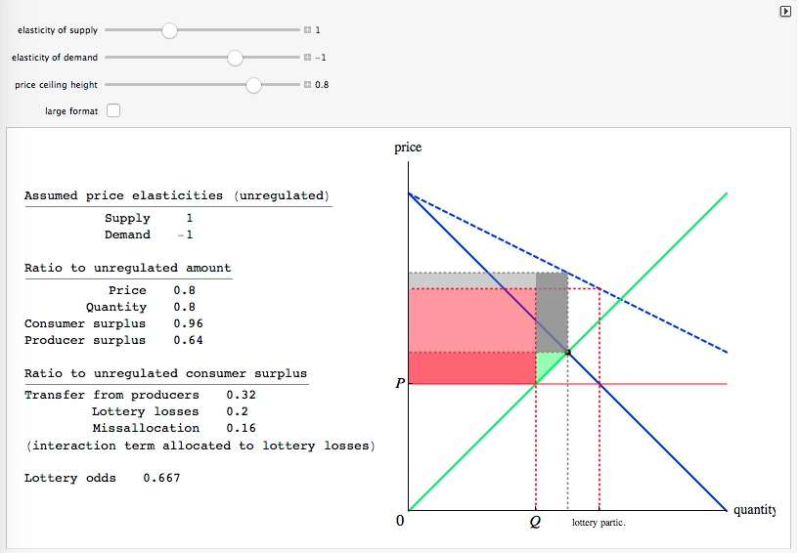
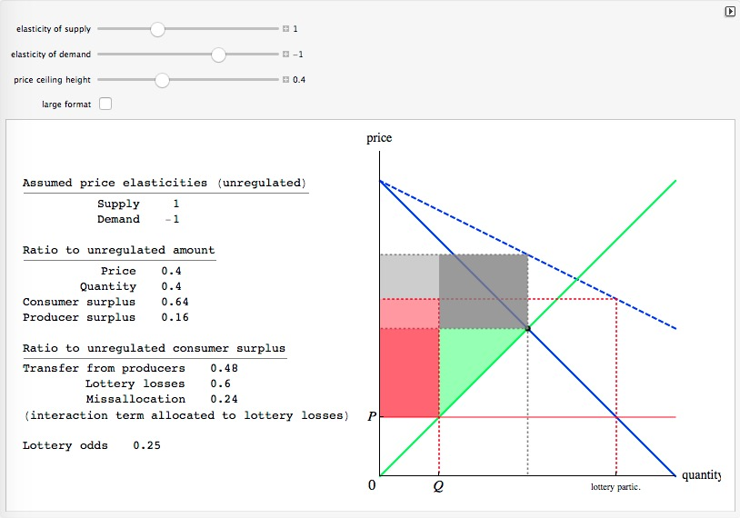
Allocation by Lottery Market Simulation
Notes:
The interaction/overlap between lottery losses and misallocation is assigned to the latter.

Slide 25
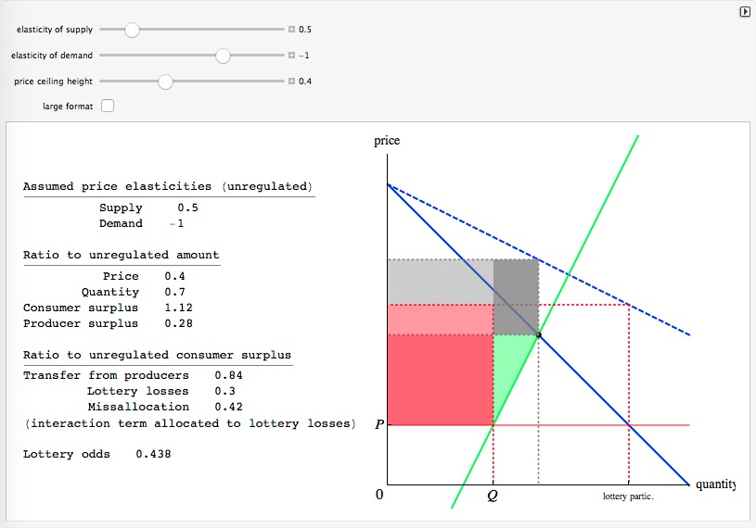
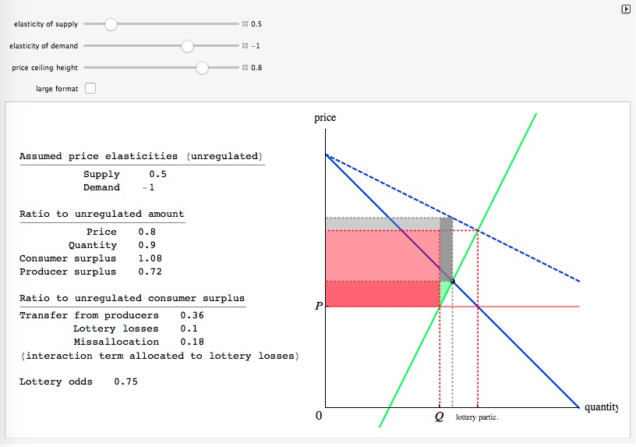
Allocation by Lottery Market Simulation

Slide 26
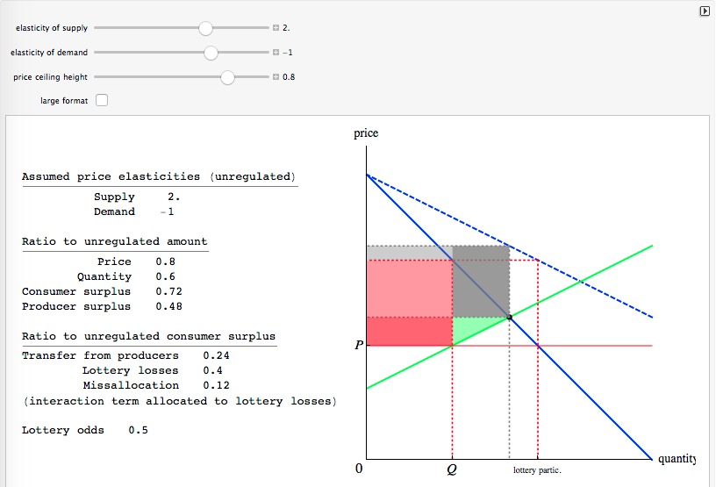
Allocation by Lottery Market Simulation

Slide 27
Lotteries Followed by Resale: An Application of the Coase Theorem (also contradicts Krugman and Wells, and most other textbooks)
Monthly rent (per apartment)
Consumer surplus: regulated
High-value lottery losers buy from low-value lottery winners.
$1,400
S
Secondary market price →
1,200
Amount lost by society
Profit from resale (gross)
1,000
goods not supplied
Price ceiling
800
More than 400,000 lottery losers
600
Lowest-value buyers participate too
D
0
1.6
1.8
2.0
2.2
2.4
Quantity of apartments (millions)

Slide 28
Rights Assigment 3: Nonprice Competition
Most real-world goods have non-price attributes such as quality that are:
Valued by buyers
Costly for sellers to provide
Can be an object of competition absent price competition
Price floor
Sellers enhance non-price attributes to compete for buyers
Price ceiling
Buyers accept fewer non-price attributes
Examples: discrimination, in-kind compensation (OJT), serving size (food), maintenance
Notes:
Ie, demand and supply are relative to the next best alternative. In a price regulation context, the next best alternative is likely a very similar good but with non-price attributes that are different enough to be compliant with the ceiling. This is not the demand curve that, say, a monopolist prices against.

Slide 29
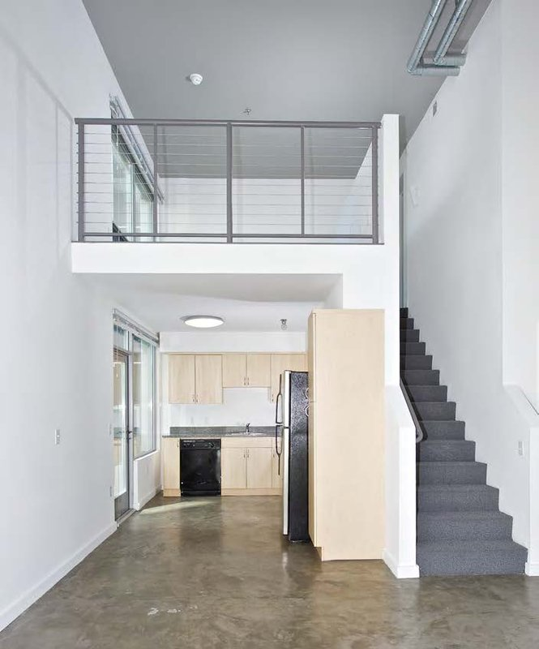
Creating more square feet with the same cubic feet
Notes:
Image credit: http://s3-media1.fl.yelpcdn.com/bphoto/U9CsBokFHCsJAwHYt5QkxQ/o.jpg

Slide 30
Non-price competition in response to controls
Monthly rent (per apartment)
What are the next-best alternatives represented here?
$1,400
S
1,200
1,000
Price ceiling
800
600
D
0
1.6
1.8
2.0
2.2
2.4
Quantity of apartments (millions)

Slide 31
Nonprice Competition Supply of, and demand for, short (low head room) apartments.
Monthly rent (per apartment)
$1,400
Supply curve reflects opportunity costs, including the opportunity of using the same cubic footage for tall apartments
1,200
S
1,000
Price ceiling
800
$800 ceiling = less opportunity cost
600
D
0
0.6
0.8
1.0
1.2
1.4
Quantity of short apartments (millions)
Notes:
These supply and demand curves are more elastic, because the alternative is another type of apartment

Slide 32
Nonprice Competition Large deviations from competition shift demand more than supply. Unregulated supply and demand shown with dashes. (also contradicts Krugman and Wells, and most other textbooks)
Monthly rent (per apartment)
$1,400
S
Savings on nonprice attributes
1,200
Less valuable product
S’
1,000
Price ceiling
800
600
D
D’
0
1.6
1.8
2.0
2.2
2.4
Quantity of apartments (millions)

Slide 33
Nonprice Competition Small deviations from competition shift demand and supply equally. Unregulated supply and demand shown with dashes. (also contradicts Krugman and Wells, and most other textbooks)
Monthly rent (per apartment)
$1,400
S
S’
1,200
Price ceiling
1,000
800
600
D
D’
0
1.6
1.8
2.0
2.2
2.4
Quantity of apartments (millions)

Slide 34
Nonprice Competition Equilibrium quantities for various ceilings. Unregulated supply and demand shown with dashes. (also contradicts Krugman and Wells, and most other textbooks)
Monthly rent (per apartment)
$1,400
S
See also Summers “Mandated Benefits”
1,200
Price ceiling
1,000
800
600
D
0
1.6
1.8
2.0
2.2
2.4
Quantity of apartments (millions)

Slide 35
Rights Assigment 3: Nonprice Competition
Quantity traded depends on both demand and supply.
E.g., despite a price floor, a tax on suppliers will reduce supply
Quantity effect is essentially zero in the neighborhood of the competitive outcome
(need to be clear on how quantity is defined)
Both consumers and producers are typically worse off

Slide 36
Queues 201
Wait time is a product attribute
Absent regulation, suppliers spend resources to reduce customer waiting

Slide 37
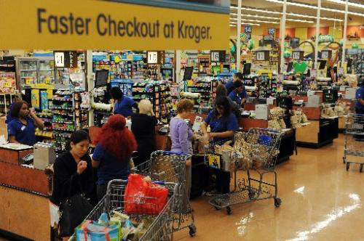
Is Customer Waiting Evidence of Waste?
Notes:
Image credit: Steve Pfost. http://www.reporterherald.com/ci_20194225/supermarket-checkout-still-stuck-past

Slide 38
Nonprice Competition Small deviations from competition shift demand and supply equally. Unregulated supply and demand shown with dashes. (also contradicts Krugman and Wells, and most other textbooks)
Monthly rent (per apartment)
$1,400
S
S’
1,200
Price ceiling
1,000
800
600
D
D’
0
1.6
1.8
2.0
2.2
2.4
Quantity of apartments (millions)

Slide 39
Queues 201
Wait time is a product attribute
Absent regulation, suppliers spend resources to reduce customer waiting
Quantity traded depends on the price regulation, the effect of queues on supply costs, AND the characteristics of the buyers (e.g., their income)
Quantity traded is less than competitive
Consumers are typically worse off (the marginal consumer is always worse off)

Slide 40
Quality-Quantity Substitution
Sometimes quality and quantity are substitutes
Distinguish the aggregate number of units purchased from the aggregate consumer value of those units
E.g., square feet of apartment space vs. housing services
Price ceilings can increase the number of units purchased!

Slide 41
Nonprice Competition with a quality-quantity tradeoff. Unregulated supply and demand shown with dashes. (also contradicts Krugman and Wells, and most other textbooks)
Monthly rent (per apartment)
$1,400
S
1,200
Price ceiling
1,000
800
600
D
0
1.6
1.8
2.0
2.2
2.4
Housing services

Slide 42
Nonprice Competition with a quality-quantity tradeoff. Unregulated supply and demand shown with dashes. (also contradicts Krugman and Wells, and most other textbooks)
Monthly rent (per apartment)
$1,400
S
1,200
Elasticity = -1
Price ceiling
1,000
800
600
D
0
1.6
1.8
2.0
2.2
2.4
Square feet of apartments (billions)

Slide 43
Who has the property rights?
Who determines how the good is made?
Who has the right to grant exemptions?
Who assigns the right to use?
Buyer takes the good by force: conscription, taxation in kind
Seller decides, or it is part of the regulation

Slide 44
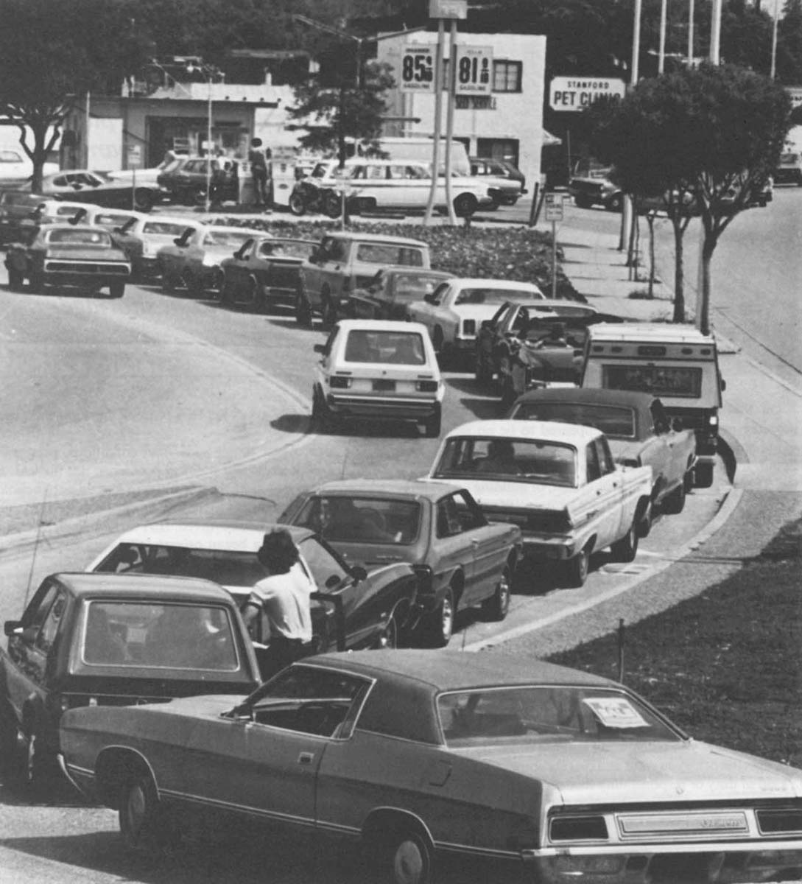
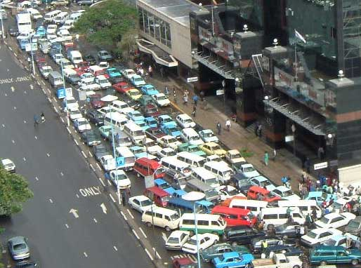

Slide 45
A Lottery Allocating Goods to Buyers: Consumer surplus and the Average Benefit curve
Monthly rent (per apartment)
High-value buyers removed from the market.
Their numbers depend the lottery chances.
$1,400
S
1,200
Low-value buyers added to the market.
Their numbers depend on price elasticity of demand and the lottery chances.
1,000
Price ceiling
800
AB
600
D = MB
0
1.6
1.8
2.0
2.2
2.4
Quantity of apartments (millions)

