Slide 1
Taxation in Kind
with special attention to
Military Manpower Conscription
by Casey B. Mulligan
Notes:
1

Slide 2
Taxation in Kind
examples
  conscription of manpower by the military or civil service
  conscription of materials and factories by the military
  eminent domain (land, intellectual property)
  jury duty
  human organs
  nationalization of industry
  regulatory taking?
how do these taxes affect the economy?
what is the optimal use of in-kind taxes?
what is the political economy of in-kind taxes?
despite work on cash vs. in-kind transfers, practically no work on in-kind taxes
  exception: Vietnam era literature on volunteer vs drafted army and more recent law & econ work on eminent domain
Notes:
Zapruder film (of the JFK assassination) was taken by the power of eminent domain; quartering of soldiers
horses and mules taken during civil war

Slide 3
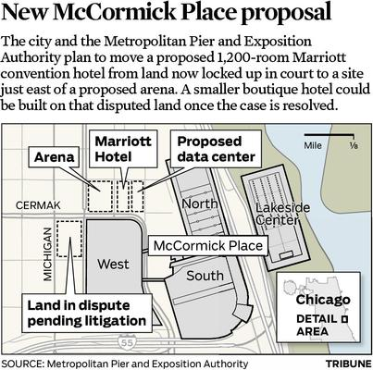

In-Kind Taxation for Private Use
Historical examples
  WWII BMW factory workers
  urban renewal
  utility company easements
should the public sector auction off the power of eminent domain?
Notes:
http://cache.boston.com/resize/bonzai-fba/Globe_Photo/2009/01/30/1233355683_0284/539w.jpg
http://media.trb.com/media/graphic/2014-01/79034725.jpg
3

Slide 4
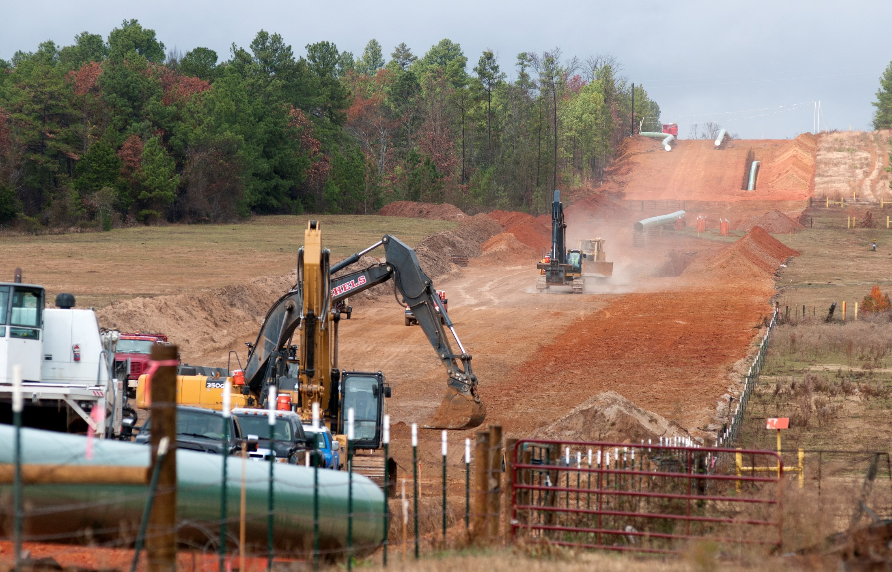
Notes:
https://thenypost.files.wordpress.com/2014/02/keystone_pipeline_88049733.jpg
In this Dec. 3, 2012 file photo, crews work on construction of the TransCanada Keystone XL Pipeline near County Road 363 and County Road 357, east of Winona, Texas. In a move that disappointed environmental groups and cheered the oil industry, the Obama administration on Jan. 31, 2014, said it had no major environmental objections to the proposed Keystone XL oil pipeline from Canada. (AP Photo/The Tyler Morning Telegraph, Sarah A. Miller)

Slide 5
Main Lessons
Taxation in kind is an example of a price ceiling
A mechanism is needed for deciding who surrenders their goods/services/self
In practice, the selection resembles market selection
  Volunteers
  Exemptions and buyouts
  Systematic avoidance
Avoidance: people compete to avoid the tax

Slide 6
Nonequilibrium Prices Cannot Allocate
(by themselves)
Monthly rent
(per apartment)
$1,400
S
Who says sellers should be voluntary participants? FORCE them to supply
1,200
1,000
WANT to trade
Price ceiling
→ Begin with markets where the boundaries are sharper. E.g., military manpower, land use
800
600
D
0
1.6
1.8
2.0
2.2
2.4
Quantity of apartments (millions)
Notes:
Another difference from price ceilings is that the buyer is setting the rules.

Slide 7
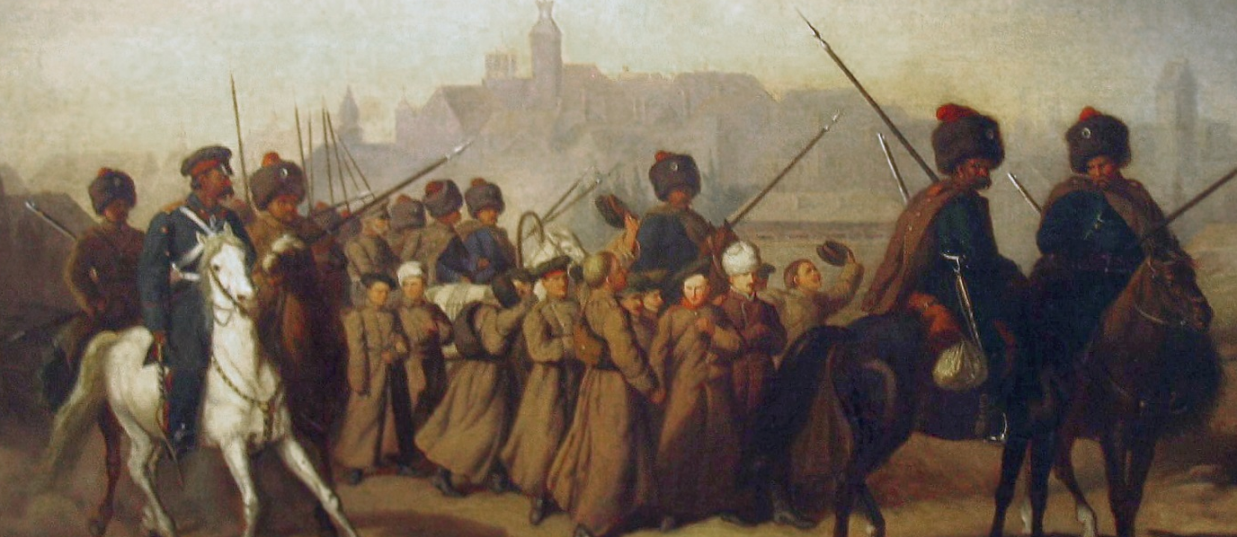
Allocation: Who Will Supply?
Version 1: Lotteries/universal
Version 2: Buyout (a.k.a. commutation or ransom) fee, or hire a substitute
Version 3: Regulators choose
Mixing these 1 & 3 with volunteers
Notes:
http://commons.wikimedia.org/wiki/File:Branka_1863.JPG

Slide 8

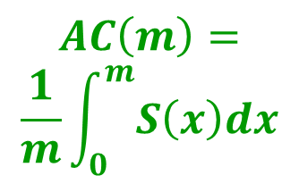
Lotteries: the AC curve again
D
D
Conscription not only eliminates seller revenue, but raises the avg. seller’s cost (by changing the average seller)
$$S\left(m\right)=MC(m)$$
social gain from market selection
All-volunteer wage
avg social cost of random selection
$$AC\left(m\right)=$$
$$\frac{1}{m}\int_{0}^{m}{S\left(x\right)dx}$$
Seller Revenue: AV
Conscription transfers this to buyer(s)
Seller surplus: AV
All-volunteer AC
0
1
m = personnel per capita
Notes:
Mention dwcs as putting more weight on the government surplus

Slide 9
Ransom: market-like selection
D
Conscription can eliminate seller revenue, without changing the average seller
$$S\left(m\right)=MC(m)$$
All-volunteer wage = commutation fee
Seller Revenue: AV
Conscription transfers seller revenue to buyer(s)
These are the sellers with AV or conscription
and revenue is obtained from those who do not sell
0
1
m = personnel per capita

Slide 10

Regulation: move down the AC curve
Use lottery if non-exempt share exceeds share demanded
D
$$S\left(m\right)=MC(m)$$
social gain from market selection
avg social cost of random selection among the non-exempt
$$AC\left(m\right)$$
Randomly exempted
Perfect exemptions
0
1
m = personnel per capita
Share exempt

Slide 11
Conscript pay is the opposite of an exemption
D
A conscript wage between zero and AV wage guarantees that the lowest cost suppliers participate
$$S\left(m\right)=MC(m)$$
All-volunteer wage
Conscription w/ pay: transfers part of seller revenue to buyer(s)
Conscript wage
Conscript wage guarantees their participation
0
1
m = personnel per capita

Slide 12
Allocation: Who Will Supply?
Version 1: Lotteries/universal
Version 2: Buyout (a.k.a. commutation) fee, or hire a substitute
Version 3: Regulators choose
Mixing these 1 & 3 with volunteers
Notes:
http://commons.wikimedia.org/wiki/File:Branka_1863.JPG

Slide 13
(1) Exemption/ avoidance
$$\frac{U.S.pop. today}{Union pop. 1861}≈14$$
(2) Ransom
(3) Volunteers
Notes:
e.g., NY had 186,647 white males aged 15-19 in 1860 (p. 592 of https://archive.org/stream/populationofusin00kennrich#page/592/mode/2up/search/age) and 151,488 drawn (Table IV of Murdock). Ie, the “drawn” is about 4 cohorts of men. Total Union population was 22 million. Enlistment is about proportional to WWII.
Lessons from this slide: (a) a lot of avoidance and (b) already a hint of systematic selection

Slide 14
The Prevalence of Volunteers

Slide 15
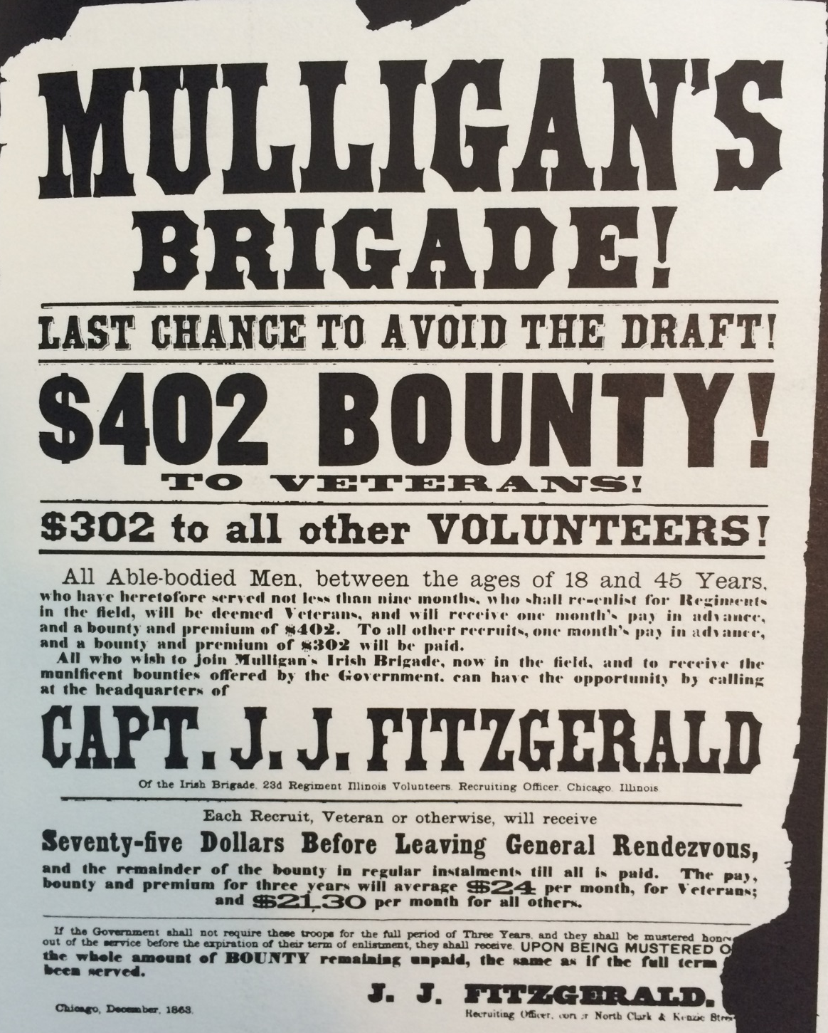

Slide 16
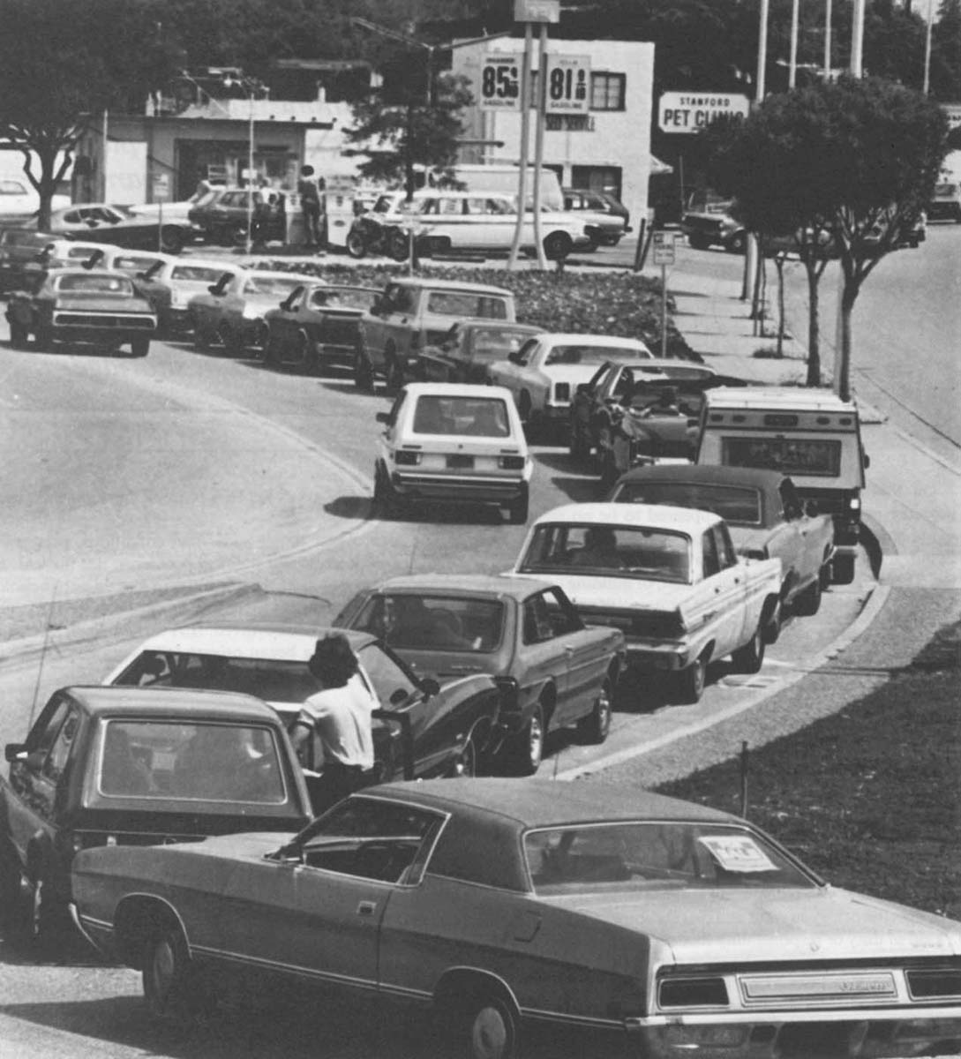
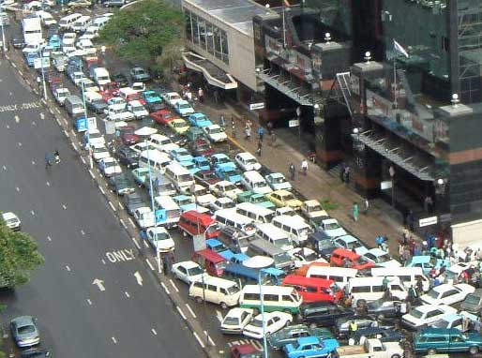
Competition for Rents

Slide 17
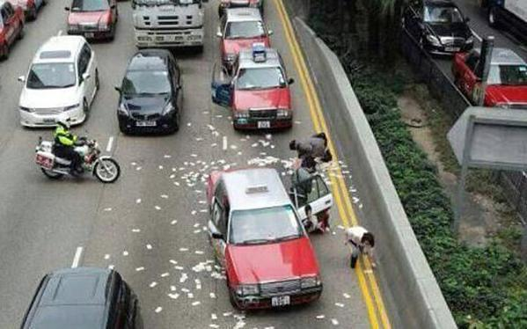
12/24/14: A security van in Hong Kong spilled bundles of banknotes … paralyzing traffic and igniting a scramble by passers-by to collect the money.
Notes:
http://www.upi.com/Top_News/World-News/2014/12/24/2-million-missing-after-cash-spill-on-Hong-Kong-road/8621419441682/

Slide 18
Rent Seeking
More precisely, “negative rent avoidance”
Modify the property to be taken so that the taker (e.g., military) does not want it
Conscription-age people modify their bodies
  Gain weight
  Sever digits
  Emigration
Landowners sabotage potential habitats for endangered species
Agricultural tiling in front of utility easements

Slide 19
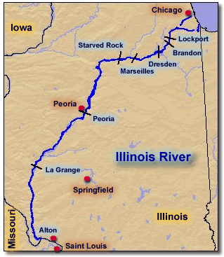
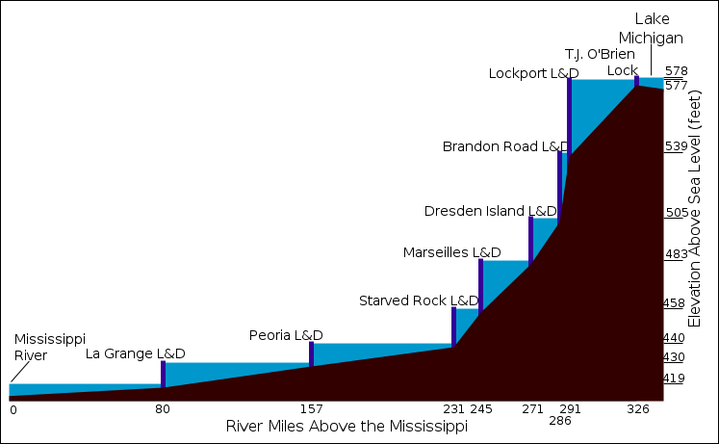
Illinois farm land is flat!
Illinois River falls only 1.1” per mile
Notes:
http://www.umesc.usgs.gov/rivers/illinois/images/illinois_river.gif
http://en.wikipedia.org/wiki/File:Illinois_Waterway_schematic.svg

Slide 20

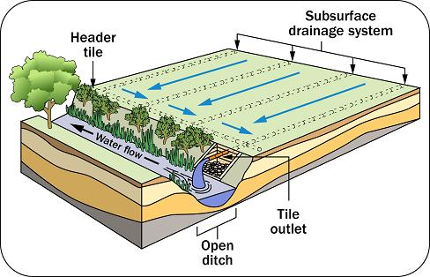
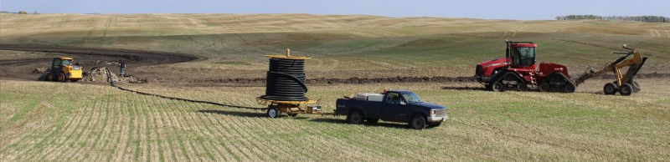
Illinois farmers consider “tiling” to drain their fields
Notes:
http://www.binaplast.com/catalog/hdpe-corrugated-subsoil-drainage-pipe
http://www.omafra.gov.on.ca/english/engineer/facts/10-091.htm
http://weckerlyfarms.blogspot.com/2014/03/drain-tiling-in-depth-look.html

Slide 21

Avoiding the Ransom
D
Suppliers avoid
$$S\left(m\right)=MC(m)$$
These are the sellers with conscription and avoidance: more average opportunity cost
commutation fee
These are the sellers with conscription (and no avoidance)
Seller losses compared with AV
Costs of avoidance
0
1
m = personnel per capita
Notes:
Here the ransom makes the selection better than random, but systematic avoidance could do that too

Slide 22
Rent Seeking is a function of conscript pay
$$S\left(m\right)=MC(m)$$
All-volunteer wage
Conscription w/ pay: transfers part of seller revenue to buyer(s)
Conscript wage
D
Potential conscripts destroy some of the property value
0
1
m = personnel per capita

Slide 23
The Scope and Conduct of Taxation in Kind
hold out
  relative to labor and materials, land is more efficiently taken because labor and materials are not subject to hold out: they are usually supplied in a competitive resale market, or can be produced from raw materials
gender, region, and occupation
  local projects will have strictly limits on the buyout rate and conscript compensation in order to achieve efficient sorting → national projects more likely to tax in kind
unskilled occupations more likely to be subject to taxation in-kind
women less likely to be drafted
cross-country data on military conscription
Notes:
what about a bullet on intellectual property?

Slide 24
Observations on Conscription Use and the Deadweight Costs of Monetary Taxes
yes, the size of the force (per capita) predicts the use of conscription
  across countries
  USSR fall followed by European shifts to voluntary army
  but, the force effects come out of many theories
proxies for dwc of taxes do not seem to be correlated with conscription use
  amount of nonmilitary spending
  nonmilitary “demand” shifters (e.g., elderly)
  GDP per capita (i.e., development leads to more efficient taxes, but not less conscription)
  why are conscripts paid?
  why aren’t more occupations drafted?
my approach answers these questions, and replaces the simple correlation prediction with an interaction term

Slide 25
Regulatory Complementarity and Increasing Returns
regulations have some costs that are fixed in the sense that they grow less-than-proportionally with the population to be regulated
  adoption: testing the law, reaching a political consensus
  administration, enforcement
some regulatory resources are general (i.e., apply to many regulatory areas)
  mobilized interest groups
  networks of compliance officials
costs of conscription
  “The costs to government of implementing and using replacement decreased in some ways over time, as central government enlarged its bureaucratic and coercive reach.”
  “The habit of regular and thorough communication between different levels of administration.”
→ legal origin and population should have similar “effects”
Notes:
25

Slide 26
Types of Military Manpower Systems
all-volunteer (since 1970, about 1/3 of countries)
  hereafter, “volunteer”
  0 countries in our sample are all-conscript
  lowest %s volunteer are Senegal (5%), Switzerland (9%), and Turkey (15%)
universal or random conscription (20%)
  entire population of able young men
  no exemptions for college, special occupation, etc.
conscription with exemptions or deferrals (30%)
conscription with buyouts or substitutes (8%)
[impressment]

Slide 27
Countries with Buyouts (c. 1996)
Albania, Argentina, Bolivia, China, Ecuador, Egypt, Iran, Iraq, Jordan, Paraguay, Syria, Tunisia, Turkey have (probably) legal buyouts
e.g., Iran
  “PhDs and men with BAs who left Iran before March 1990 may get exempted on paying a fee of USD 16,600.... Men who left Iran after 1990 may get exempted on paying a fee of USD 1,000-3,000.”
e.g., Iraq
  “It is possible to get exempted from service by paying a sum of money. In 1998 this was believed to be 10,000 USD.”
e.g., China
  “Given the economic prosperity of [some] areas, young people seem quite willing to pay the fines imposed for non-compliance with the conscription law.”

Slide 28
manpower cost envelope

Slide 29
Why Nixon Drafted, but Bush didn’t
U.S. has common-law origin
is noncommunist and democratic
1970: population was 205 million
  about 18 million men aged 15-24
  armed forces were 3.1 million
  our model predicts 58% draft likelihood
2003: population was 290 million
  about 21 million men aged 15-24
  armed forces were 1.4 million
  our model predicts 43% draft likelihood
  if armed forces doubled, only 53% likely

Slide 30
Further Readings on this Approach
Mulligan and Shliefer
  “Conscription as Regulation.” American Law and Economics Review. 7(1), Spring 2005: 85-111.
  “The Extent of the Market and the Supply of Regulation.” Quarterly Journal of Economics. 120(4), November 2005: 1445-73.
Glaeser and Shliefer
  “Legal Origins.” Quarterly Journal of Economics. 117(4), November 2002: 1193-1229.

Slide 31
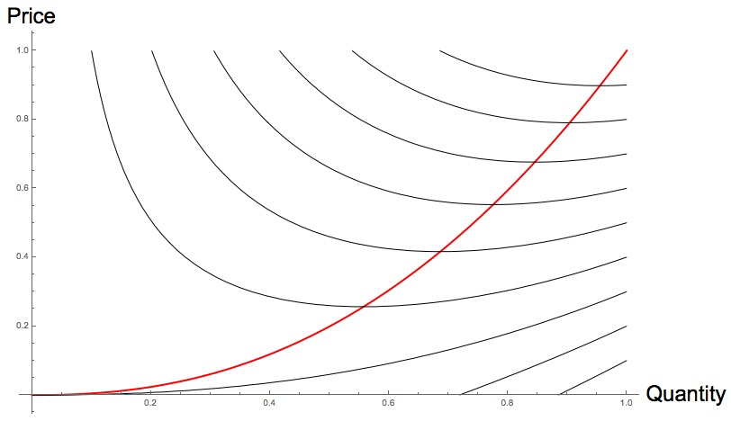
A Positive Theory of Conscription
Grey curves are supplier-indifference curves. The red curve is supply: the quantity that maximizes supplier utility given price.
Society can take an action that increases demand to 0.75. AV might give “too much” surplus to suppliers.
Supplier indifference curves
Volunteers
AV
Suppliers’ gain
Ceiling
Conscription
Baseline
Notes:
MurphySupplyFootball.nb

