Slide 1
Market Analysis
Few taxes are levied on “Robinson Crusoes”
Market results are often quite different than Robinson-Crusoe results
General theory: Equalizing differences (Smith/Rosen)
General theory: Market demand vs individual demand
Anti-trust penalties (Baker)
Investment tax credits (Goolsbee)
Unemployment benefits and layoffs (Topel & Welch)
Learning by doing is not free (Rosen)
Anti-competitive effects of the employer penalty

Slide 2
Market Analysis: Examples
Unemployment insurance subsidizes layoffs --> more layoffs (Topel and Welch)
Investment tax incentives increase the investment expenditure but not the quantity of investment (Goolsbee)
Penalizing high prices does not reduce prices if the customers receive the damanges (Baker)

Slide 3
Market Analysis: Example
Each individual employer has to offer the same benefits to all of his employees
Absent benefits, all employers have the same composition of employees
Only 25 percent of employees want an employer that has a paid education program, but lower salaries
Market analysis
A combination of sorting (some specialize in offering employer education) and compensating differences (employees that want the program get paid a premium to work without it)
Does not assume perfect sorting
Robinson-Crusoe analysis:
Zero employers have paid education programs because 75% of their employees don’t want them
The 25 percent are in conflict with the 75 percent
E.g., Gruber GMSIM, CBO HISM, Urban’s HIPSM, RAND

Slide 4
Example: The Urban Institute
“Most employers hire a mix of workers who face different circumstances…”
“Not all workers will be pleased with any one [employer] decision…”
“pleased” relative to what?
“… evidence suggests that the preferences of workers that are the most difficult to replace (e.g., highly skilled, often higher earners) will tend to carry the most weight in employer decision-making.”
Notes:
Blumberg et al “Why Employers Will Continue to Provide Health Insurance: The Impact of the Affordable Care Act” October 2011

Slide 5
Antitrust Remedies Frustrated
Inverse demand curve = willingness to pay for the product = D(q)
Monopolist’s cost curve C(q)
Antitrust damages
There is a probability that the monopolist is caught “overcharging” and has to pay damages to the customers.
The expected damages are M(q), which reflect, for example, that less supply restriction (more q) means less likely to be found overcharging.
Customer willingness to pay P(q) = D(q) + M(q)/q
Monopolist’s profit function = qP(q) – C(q) – M(q) = qD(q) – C(q)
Damages are irrelevant for the monopolist’s decision

Slide 6
Market Analysis Prototype: Compensating Differences
Adam Smith’s Wealth of Nations
Survey by Sherwin Rosen
Examples
Value of a Statistical Life
Employer benefits
Work schedules

Slide 7
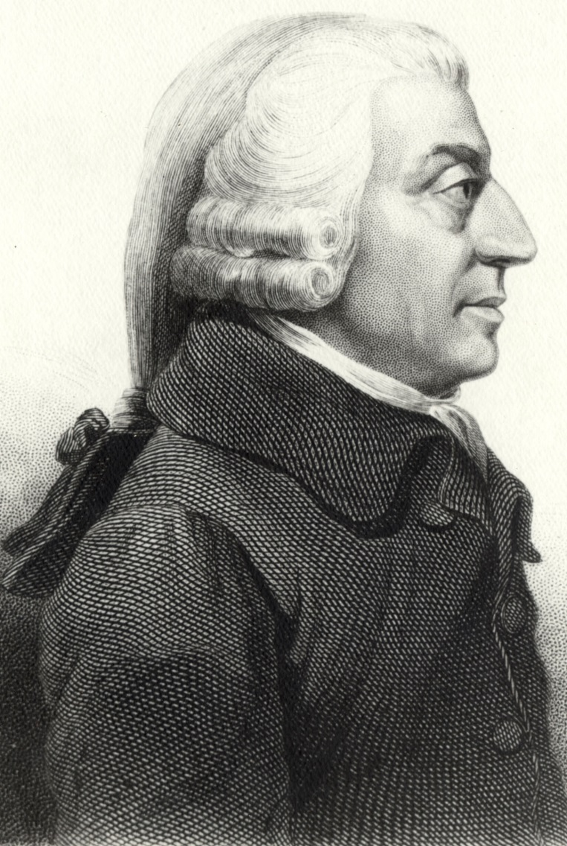
The Wealth of Nations by Adam Smith. 1776
If … there was any employment evidently either more or less advantageous than the rest,
so many people would crowd into it in the one case, and so many would desert it in the other,
that its advantages would soon return to the level of other employments.
Sources: Public domain photo download from Wikipedia Commons and credited to Etching created by Cadell and Davies (1811), John Horsburgh (1828) or R.C. Bell (1872).

