Slide 1
Public Sector Economics
Comparative Public Finance

Slide 2
Very Common Areas of Nearly Total Public Monopoly
law and order
defense
post office
(in developed countries)
pensions
medicine
schooling
banking

Slide 3
Measuring the Size of Government
Public enterprises (ie, public provision of private goods). Which should be included as gov spending:
  value-added?
  the amount of the subsidy
regulation
tax credits
transfer payments

Slide 6
Long-Term Government Growth in 7 countries
(Mitchell, B.R. International Historical Statistics)
spending has grown in all upper and middle income countries
mainly a 20th century phenomenon (see U.K. )

Slide 7
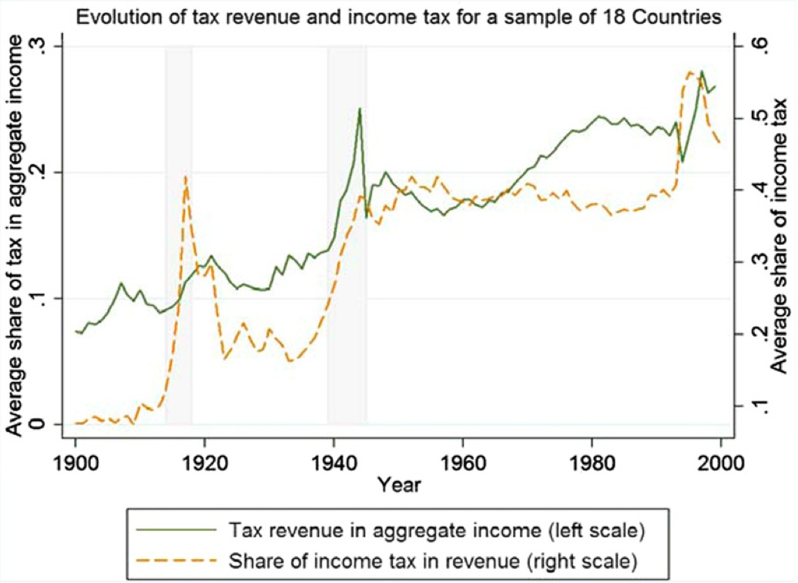
Source: Besley and Persson. 2013

Slide 8
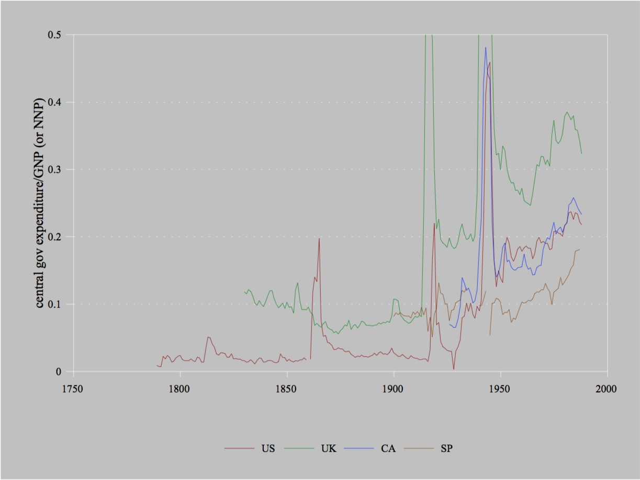

Slide 9
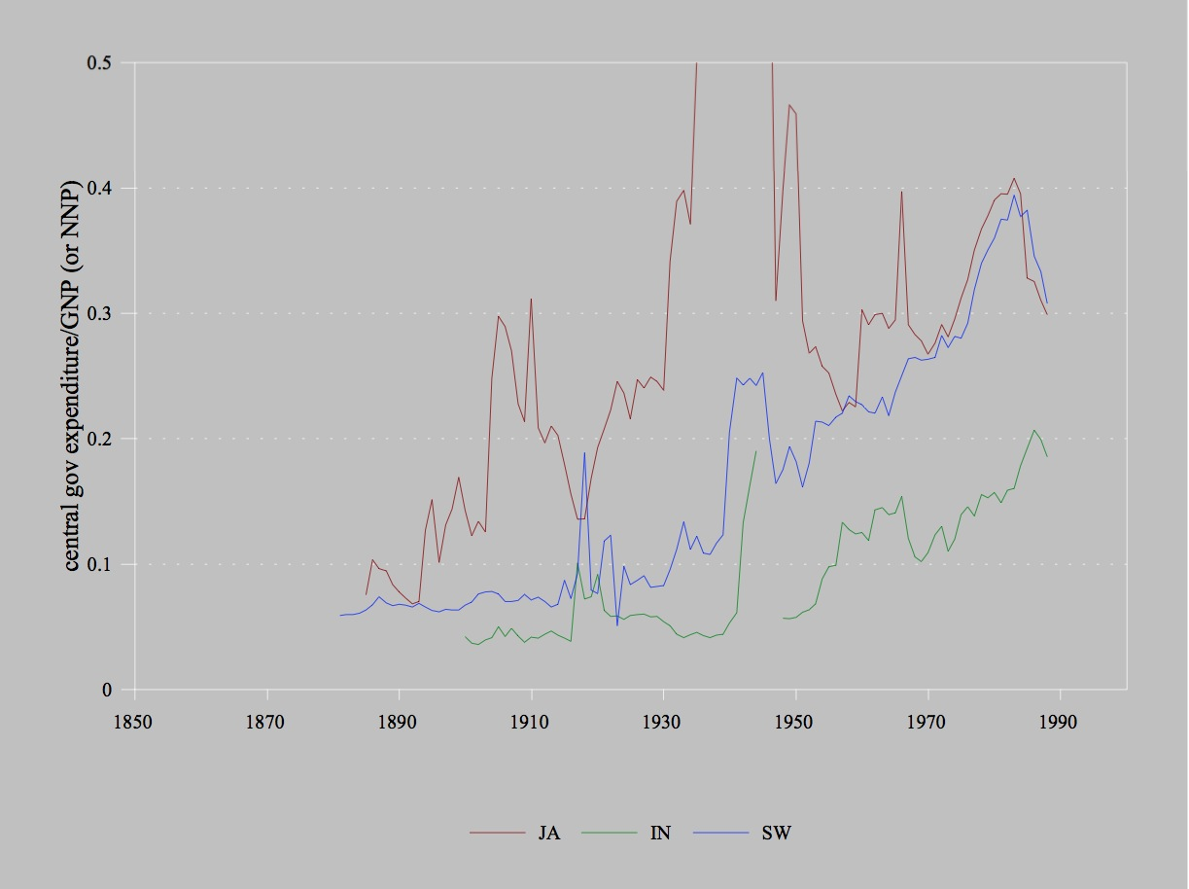

Slide 10
Long-Term Government Growth in 7 countries
(Mitchell, B.R. International Historical Statistics)
spending has grown in all upper and middle income countries
mainly a 20th century phenomenon (see U.K. )
decline of Customs taxes
  US, UK, CA, SW
  growing in India
  low level and less trend in JA and SP
    JA: a first lesson in measuring government policy
    small tax rates do not necessarily mean small distortions
    small tax revenues do not necessarily mean small tax rates

Slide 11
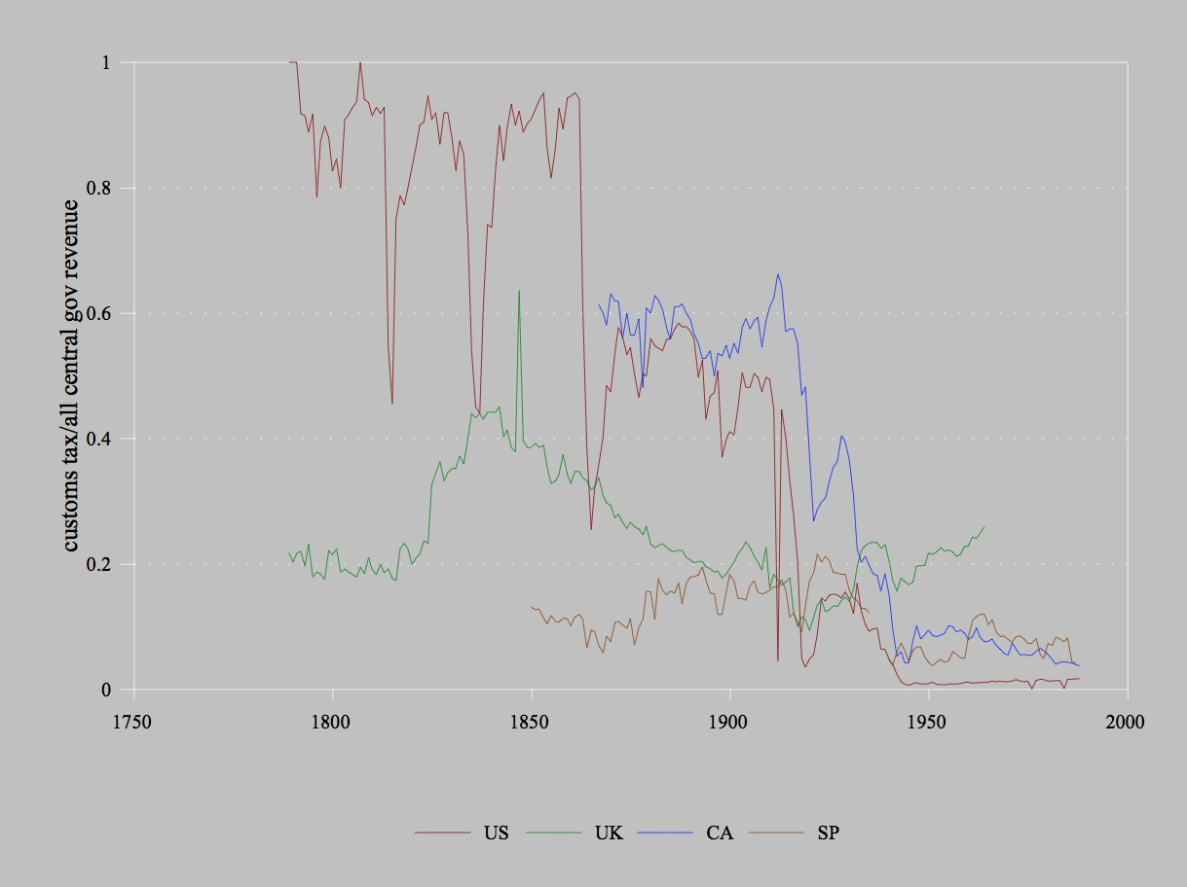

Slide 12
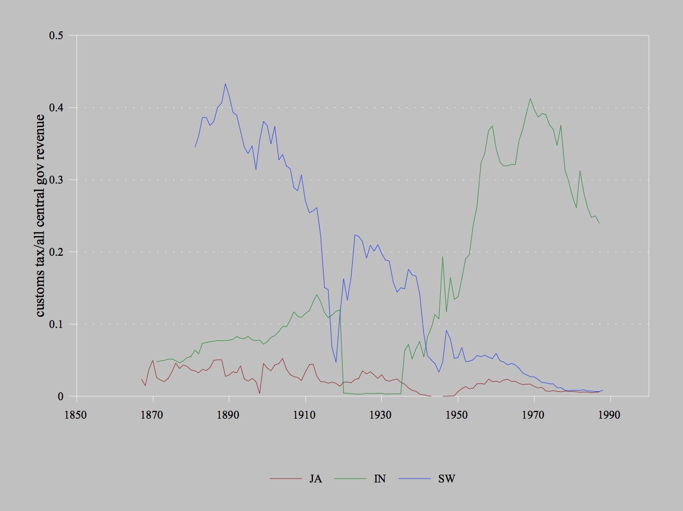

Slide 13
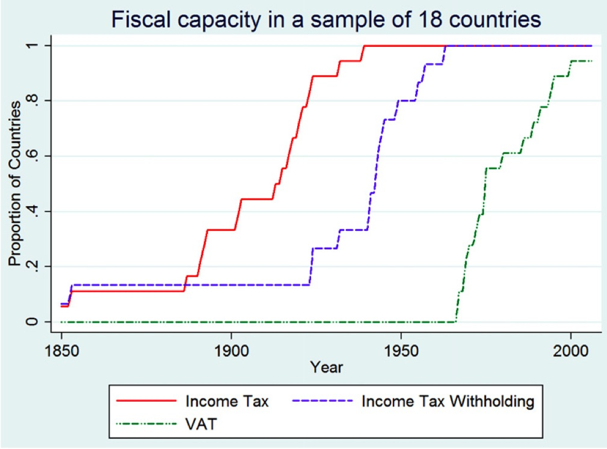
Source: Besley and Persson. 2013

Slide 14
Long-Term Government Growth in 7 countries
(Mitchell, B.R. International Historical Statistics)
spending has grown in all upper and middle income countries
mainly a 20th century phenomenon (see U.K. )
decline of Customs taxes
  US, UK, CA, SW
  growing in India
  low level and less trend in JA and SP
    JA: a first lesson in measuring government policy
    small tax rates do not necessarily mean small distortions
    small tax revenues do not necessarily mean small tax rates
growth of payroll and personal income taxes
much government growth is transfers
see, e.g., Mueller for 17 other OECD countries

Slide 18

Confusing government spending with purchases
Dr. Chad Stone, Chief Economist, Center for Budget and Policy Priorities
“I know it sounds strange to people used to talking about “out-of-control” government spending, but changes in combined federal and state and local spending on goods and services have made a negative contribution to economic growth since 2009 — not because government spending has been growing, because it has not.” [written testimony. italics added]
Valerie Ramey QJE 2011
“Identifying Government Spending Shocks: It’s All in the Timing”

Slide 19
Regional Differences in Public Spending
(I.M.F. Government Finance Statistics)
poor data quality
  definition changes over time and across countries
  keypunch errors
  discontinued by IMF
1972-90
“latitude” pattern
  ie, development. or aging?
  exceptions: Chile, Israel, Egypt, Syria, Congo, Gabon

Slide 20
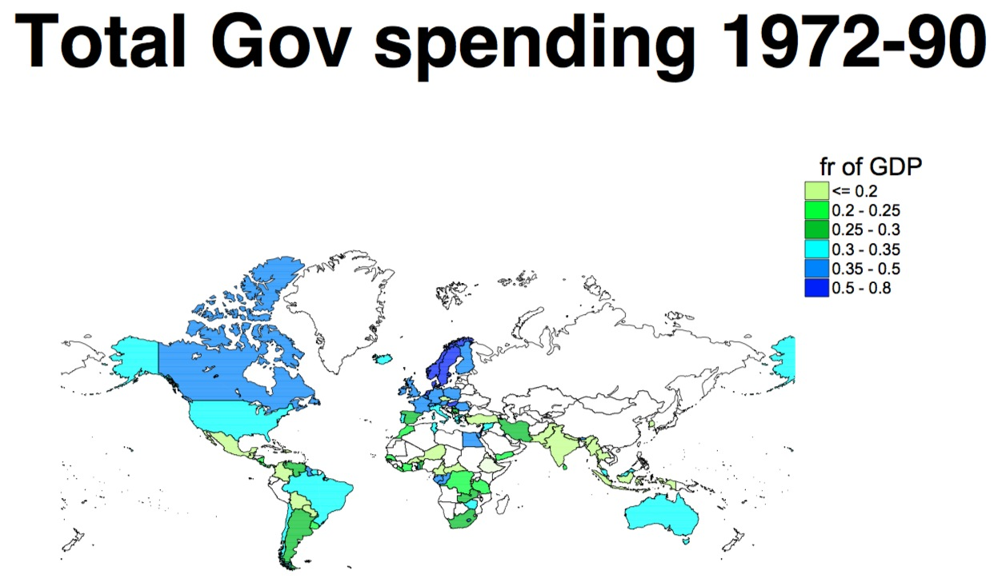

Slide 21
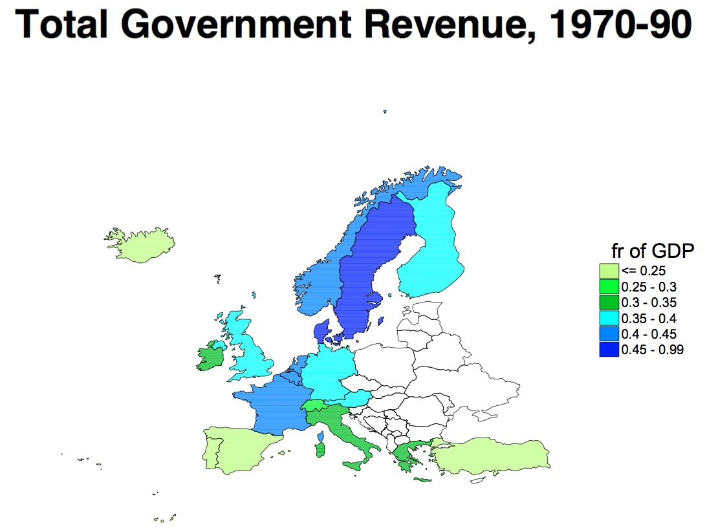

Slide 22
Regional Differences in Public Spending
(O.E.C.D. Social Expenditure Database)
O.E.C.D. country-years since 1980 only
good data quality. esp. spending comparisons for detailed categories
main categories
  old age (OA) cash
  disability (DI) cash
  occupational injury and disease
  sickness (HI)
  services for OA & DI
  survivors (S)
  family cash
O.E.C.D. data less detailed prior to 1980
  family services
  active labour market programmes
  unemployment (UI)
  public expenditure on health
  housing
  other contingencies

Slide 23
The Prevalence of Wage and Wage-like Taxes
many taxes can often be analyzed as if they were labor-income taxes (proof next lecture):
  payroll taxes
  personal income taxes
  sales taxes
  value-added taxes
  conscription (?)
these taxes bring in a sizeable majority of all government revenue

Slide 25
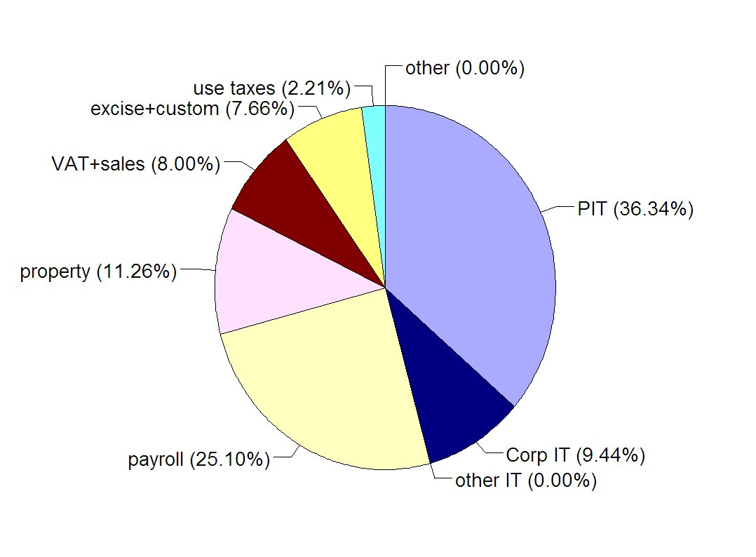
The Composition of Taxes in the United States

Slide 26
The Composition of Taxes in OECD Countries
Notes:
2011. http://dx.doi.org/10.1787/888933155029

Slide 27
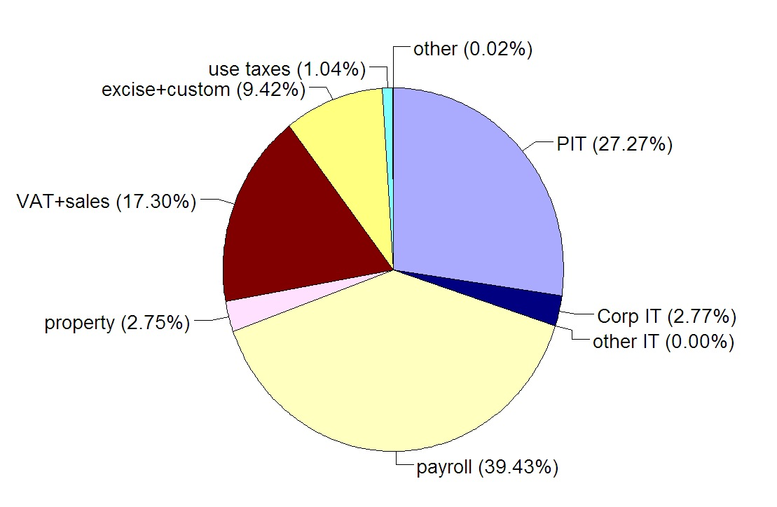
The Composition of Taxes in Germany

Slide 28
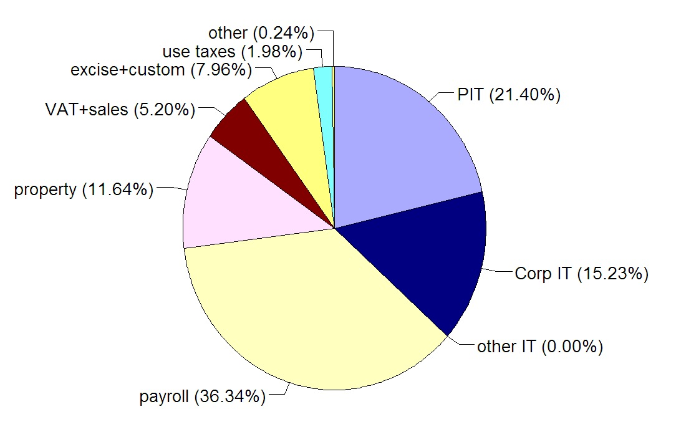
The Composition of Taxes in Japan

Slide 29
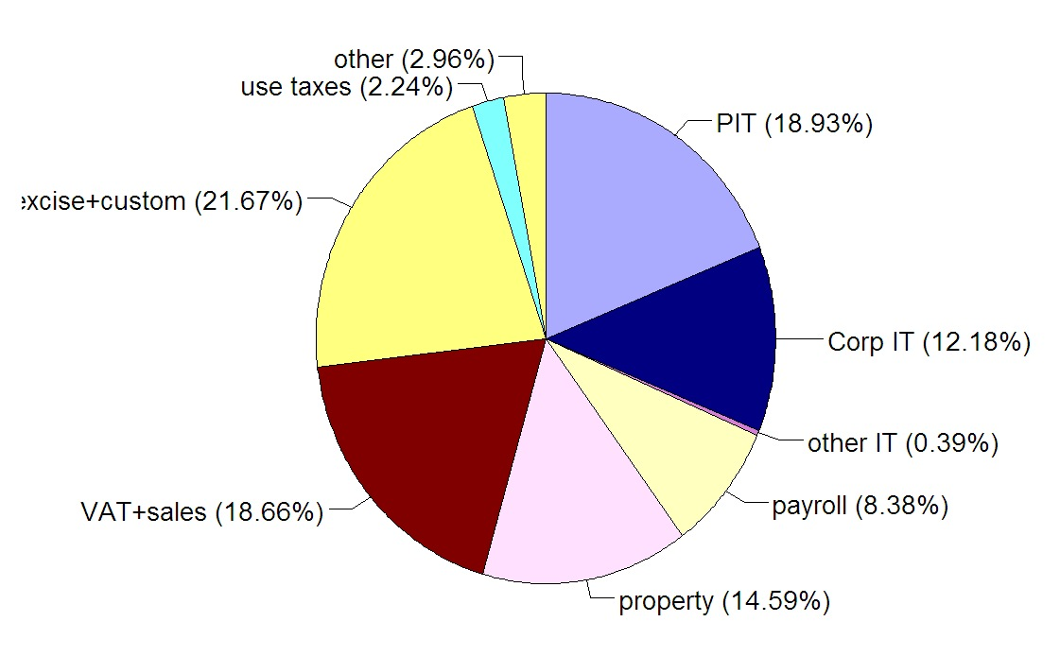
The Composition of Taxes in S. Korea

Slide 30
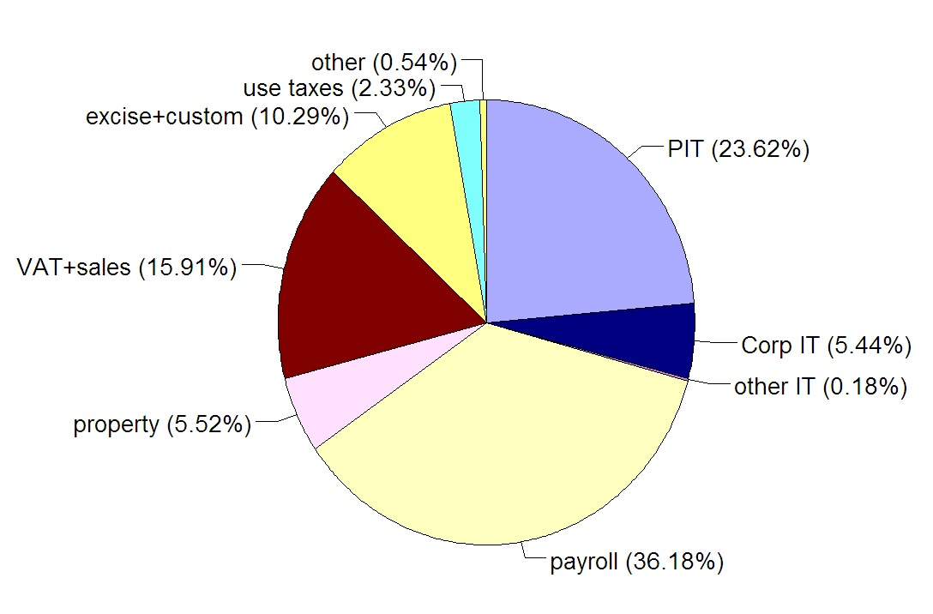
The Composition of Taxes in Spain

Slide 31
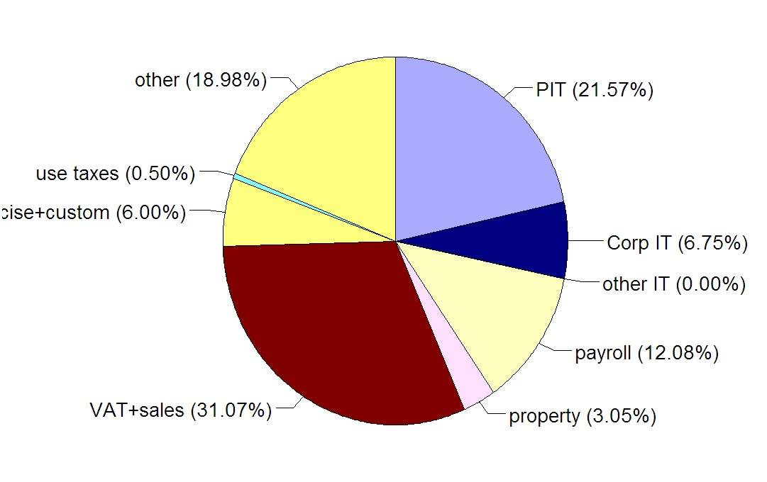
The Composition of Taxes in Turkey

Slide 33
Includes implicit taxes,
esp. employment taxes

Slide 34
Notes:
Primarilyy economic trends: low-skill wages going down, with cash benefits fixed and medical benefits getting more valuable

Slide 38
Social Security Across Countries
common characteristics (88 country sample, 1995)
  98% “pay-as-you-go”
  97% of countries use payroll tax
  91% have “shared” payroll tax
  85% have benefits increasing with lifetime earnings
  75% induce retirement (ie, reduce benefits with earnings or work status)
  89% do not reduce benefits with asset income
payroll tax magnitude is unappreciated
  75% of U.S. taxpayers pay more in PT than PIT
  rates near 50% in some countries
“latitude” pattern – apparently both an age and income effects

Slide 39
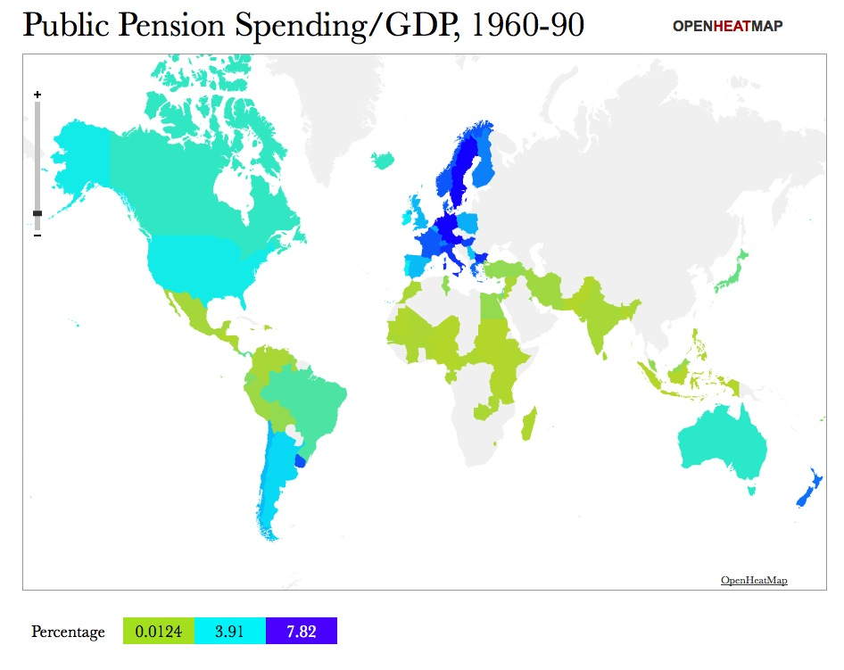

Slide 40
Employment vs Earnings Tests
benefit amount
b₀
earnings-tested benefit
(magnitude of) slope = “benefit reduction rate”
employment-tested benefit
beneficiary earnings
0

Slide 41
Variations on the Employment Test
benefit amount
b₀
employment-tested benefit
beneficiary earnings
0

Slide 42
Variations on the Employment Test
benefit amount
b₀
employment-tested benefit
beneficiary earnings
0

Slide 43
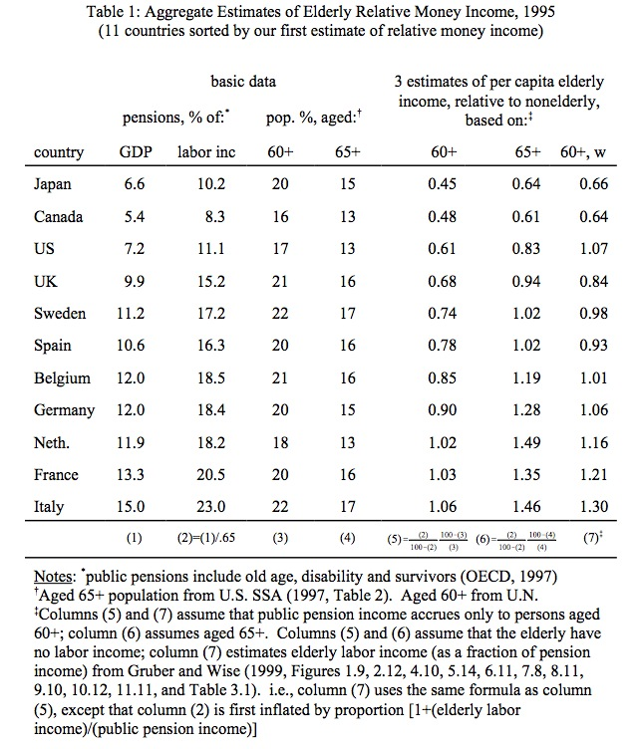

Slide 44
How does elderly’s population slice compare to its group-income slice?
Calibrated to Italy 1995

Slide 45
How does elderly’s population slice compare to its group-income slice?
Other elderly wage income
Public pension
Calibrated to Italy 1995

Slide 47
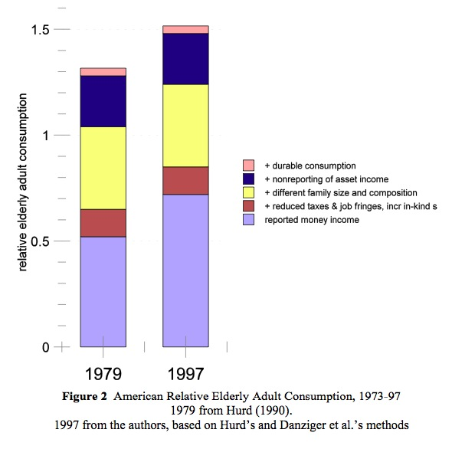

Slide 48
Capital Taxation Over Time

Slide 49

Measuring “the” capital income tax rate
$$τ_{t}=\frac{T_{t}+P_{t+1}}{R_{t}+P_{t}}$$
Taxation of a “representative” piece of capital
T_{t} = date t direct capital income tax revenues
  corporation income taxes
  estimate of personal capital income taxes
  federal, state, and local
  dated according to payer’s tax year
P_{t} =property tax revenue paid in year t
R_{t}= aggregate capital income (after indirect business taxes, before direct taxes)
does not depend on how the capital stock is measured
see also Auerbach (1983, on reading list) and related calculations by Lucas, Mendoza et al

Slide 50
Sources of Measured Corporate Rate Changes
1913 income taxation becomes constitutional
early 1940’s statutory rate increased to 38%
1949-52 statutory rate increase from 38 to 52%
1964 statutory rate cut from 52 to 48%
1968 Vietnam War surcharge
1967-69: ITC suspended
1979 statutory rate reduced from 48 to 46%
1981-83 reduced inflation, accelerated depreciation
1986-88 statutory rate reduced from 46 to 34%, but depreciation deductions less generous
1993 statutory rate increased to 35%

Slide 51
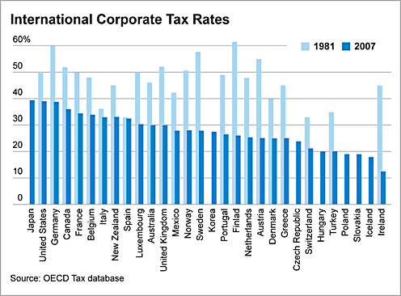
Notes:
http://www.usnews.com/dbimages/master/6339/GR_PR_080815_Tax2.png

Slide 52
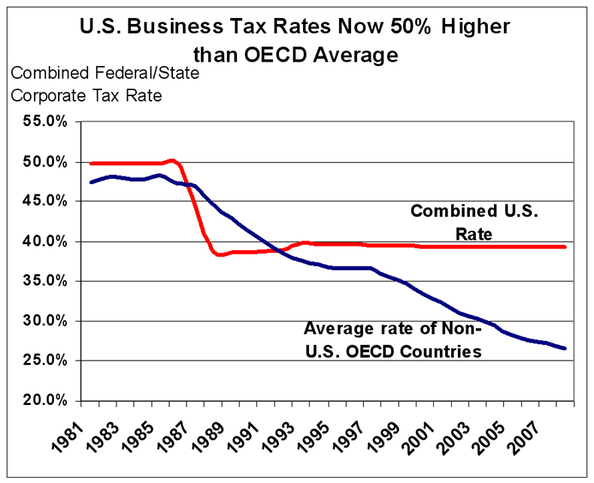
Notes:
http://taxfoundation.org/article/us-corporate-taxes-now-50-percent-higher-oecd-average

Slide 53
Relations with Democracy
only a minority of countries and people live under democracy (nondemocratic = no more voting, or competition for election that, say, Guatemala 1986-95: military control with only appearances of democracy)

Slide 54
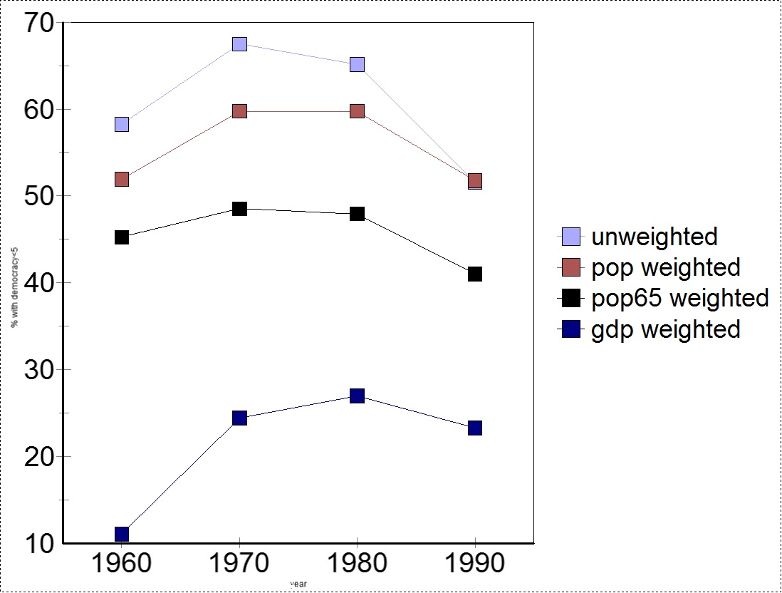

Slide 55
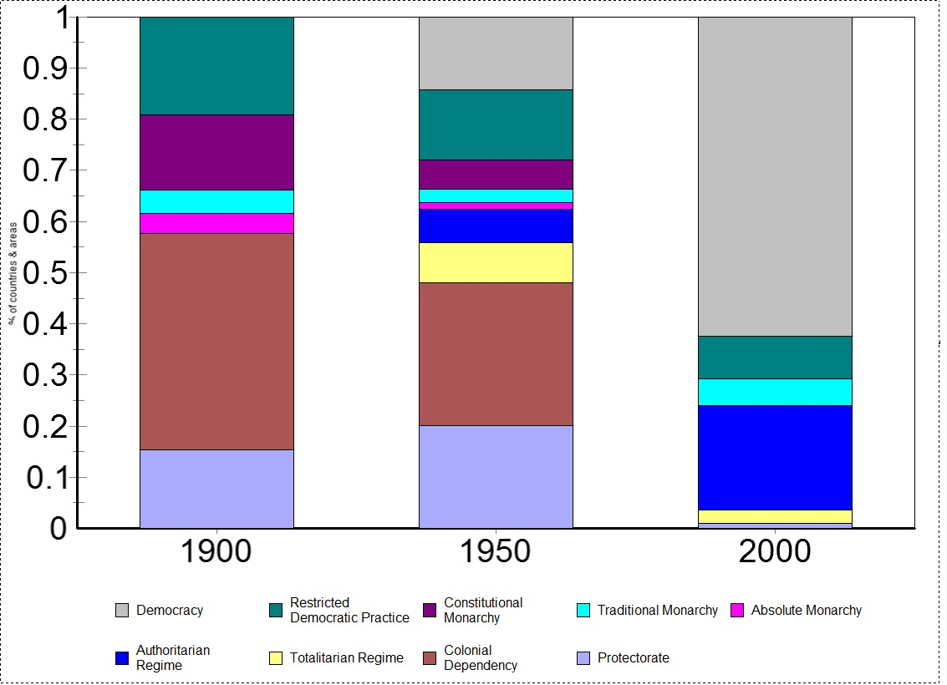
Notes:
Each country equal weight; includes colonies

Slide 56
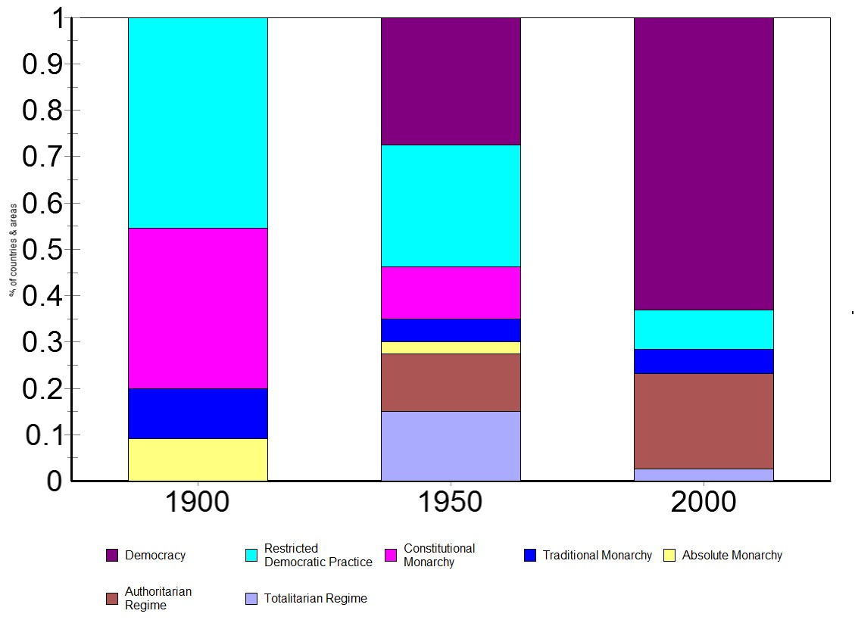
Notes:
Each country equal weight, no colonies

Slide 57
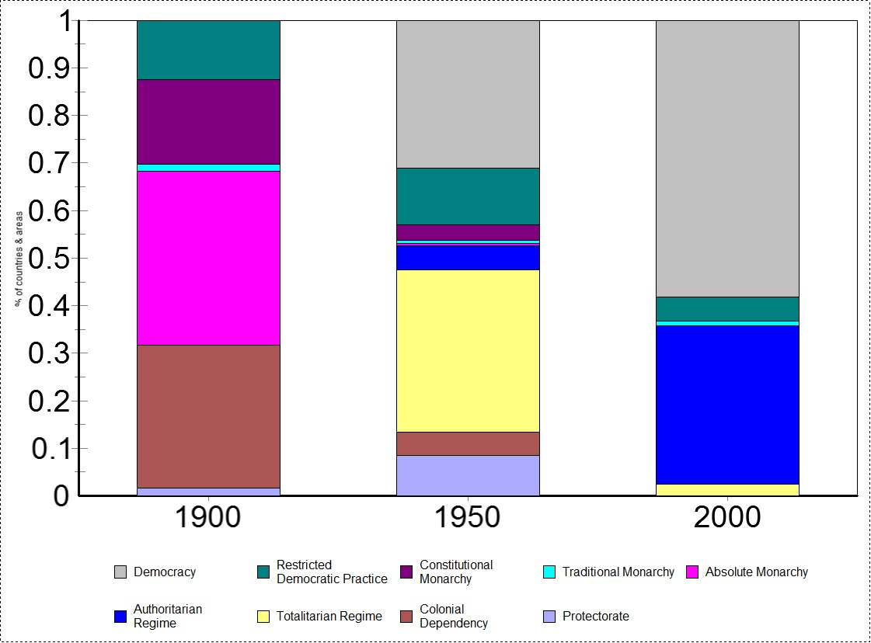
Notes:
Weighted by people

Slide 58
Relations with Democracy
only a minority of countries and people live under democracy (nondemocratic = no more voting, or competition for election that, say, Guatemala 1986-95: military control with only appearances of democracy)
democracy has “latitude” pattern
  raw (+) correlation with government spending
  zero or negative partial correlation

Slide 59
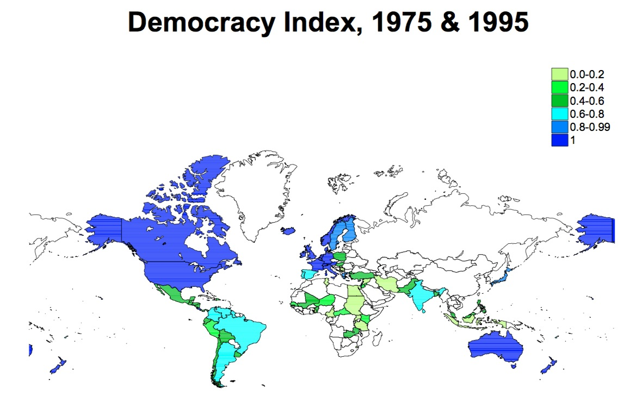

Slide 60
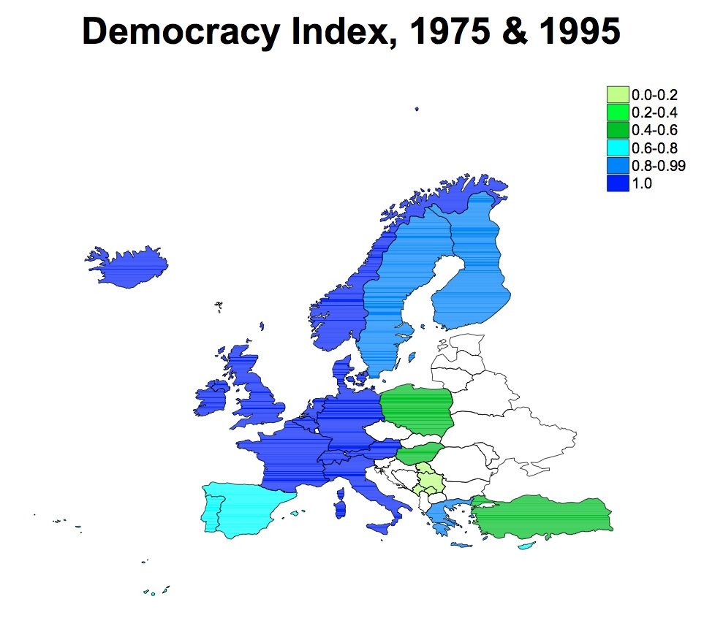

Slide 61
Relations with Democracy
only a minority of countries and people live under democracy (nondemocratic = no more voting, or competition for election that, say, Guatemala 1986-95: military control with only appearances of democracy)
democracy has “latitude” pattern
  raw (+) correlation with government spending
  zero or negative partial correlation
budget examples (controlling for GDP per cap. & communism):
  SS: Spain vs Italy
  democracies spend the same fr of GDP on:
    education, health
    pensions
    nonpension social spending
  democracies have the same corporate tax rates, and propensity to cap payroll taxes
  democracies have flatter personal income taxes
  democracies spend smaller fr of GDP on military, and have about the same amount less collected in taxes

Slide 62
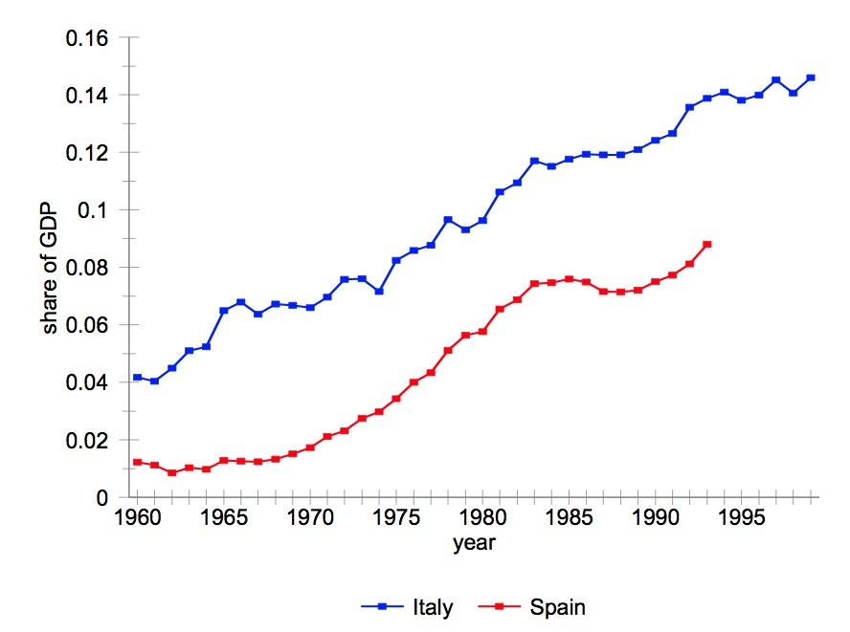

Slide 63
Relations with Democracy (cont’d)
political regulation examples (controlling for GDP per cap. & communism):
  democracies torture and execute less
  democracies censor less
  democracies regulate religion less (?)
  democracies regulate trade more (?)
military examples
  democracies spend smaller fr of GDP on military (and have about the same amount less collected in taxes)
  democracies equally likely to draft

Slide 64
Regulation over Time
measures of regulation
  revenue-analogue measure: private cost of compliance
  tax rate equivalent: wedge between supply and demand
  number of regulators employed
  number of regulations
  number of pages of regulations
  how to normalize
    population?
    GNP?
    using cross-state measures
Has federal regulation grown less than taxes?
  depends on the measure
labor regulation (more later in the quarter)

Slide 65
Regulation Across Countries
Product Market Regulation (OECD study)
  state ownership and involvement in business operation
  barriers to competition
  barriers to trade and investment
  regulatory and administrative opacity
  administrative burdens on startup
Employment Protection Regulation (anti-dismissal) (OECD study)
  procedural inconveniences
  length of notice period
  severance pay
  consequences for “unfair” dismissal
Shleifer/World Bank group. British legal origin!
  securities laws – tenant eviction
  business entry procedures – labor laws

Slide 68
