Slide 1
Prescription Drug Repositories
Alan L. Hutchison, Ph.D.
M.D. Candidate, 2019

Slide 2
What happens to medications when patients change regimens or pass away?
“It would not surprise me if as much as 20 percent of the medications we receive we end up having to destroy,” – Mark Coggins, Diversicare, Chain of 70+ nursing homes across 10 states
Colorado officials have said the state’s 220 long-term care facilities throw away a whopping 17.5 tons of potentially reusable drugs every year, with a price tag of about $10 million.
The Environmental Protection Agency estimated in 2015 that about 740 tons of drugs are wasted by nursing homes each year.
Allen M. “Wasted Medicine: America’s Other Drug Problem” ProPublica, 2017, April 27

Slide 3
Donation of unused, unopened, and unexpired medications for reuse
Although most states technically allow some leftover drugs to be recycled, Iowa is one of the few rescuing a significant percentage of the drugs from destruction. The state funds the program for about $600,000 a year, said SafeNetRx CEO Jon Rosmann, who calls it a “common sense” solution. In fiscal 2016 the program recovered and distributed drugs valued at about $3.4 million. This year it’s on pace to top $5 million.
https://safenetrx.org/
Allen M. “Wasted Medicine: America’s Other Drug Problem” ProPublica, 2017, April 27

Slide 4
SIRUM
Notes:
Founded by Stanford graduates

Slide 5
The situation in Illinois
Connections for the Homeless has a walk-in health clinic devoted to undomiciled individuals.
In addition to helping obtain health coverage, the clinic also has a full time RN and an assortment of medications and supplies
These medications are donated from local doctor’s offices where volunteer nurses work, as well as from known trusted individuals
These medications are used for
Acute asthma exacerbations
Infections
MSK
Individuals who have misplaced/lost their documentation
Notes:
I had the opportunity to volunteer here in Jan 2018 during my Family Medicine rotation, and this experience is what made me initially aware of this opportunity to improve health care access for Illinoisans.

Slide 6
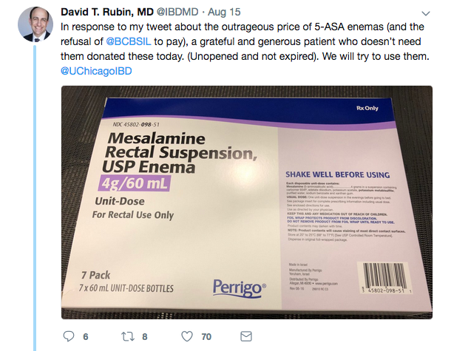
The situation in Illinois
Notes:
This is the Section Chief of GI at the University of Chicago. He is heavily involved in IBD advocacy and research.

Slide 7
Current legislation in Illinois
SB 2849 – IDPH Prescript Drug Repository
Creates the Prescription Drug Repository Program Act. Requires the Department of Public Health to, by rule, establish a prescription drug repository program, under which any person may donate a prescription drug or supplies needed to administer a prescription drug for use by an individual who meets eligibility criteria specified by the Department.
2014 – Rep. Laura Fine (D), Rep. La Shawn K. Ford (D)
2015 – Sen. Pamela J. Althoff (R), Sen. Christine Radogno (R)
2018 – Sen. Patricia Van Pelt (D)
Notes:
Note both D and R introduction of this bill.

Slide 8
The Plan
Quantify the magnitude of the problem in Illinois
Recruit peer medical and pharmacy schools and free clinics to advocate

Slide 9
Advocates at UIC are already working on this
Josiah A. Baker, PharmD Candidate, 2021
Dr. Henri Manasse, PharmD, Former ASHP Pres.
Dr. Dima Qato, MPH, PharmD
Carter McCormick, MPH, PhD candidate
Henry Okoroike, PharmD candidate
Briefing book
Objective data that would support initiation of this program

Slide 10
The Plan
Quantify the magnitude of the problem in Illinois
Recruit peer medical and pharmacy schools and free clinics to advocate
Recruit Physician Professional Societies, Patient Advocacy Societies, and local governmental institutions to participate
Petition legislators to pick up this issue
Raise awareness
…
N. Get this bill passed

Slide 11
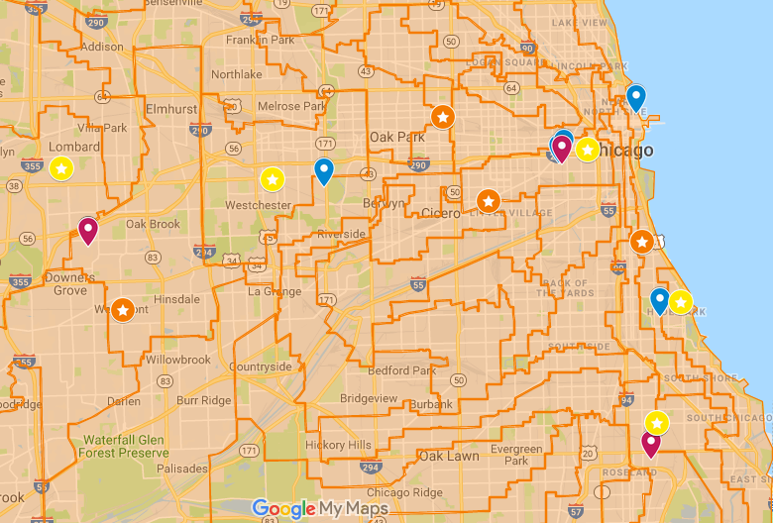
The Plan
Notes:
A map of House districts superimposed on the locations of Rep (orange) and Senator (yellow) offices (stars), medical schools (blue), and pharmacy schools (purple)

Slide 12
Why this advocacy?
“But Alan, why not just change the system so that everyone can afford medications, and we don’t need to do this donation thing?” -Tiffany
Local
Evidence of success in other states
Bipartisan
Cost-saving
Manageable
Personal

Slide 13
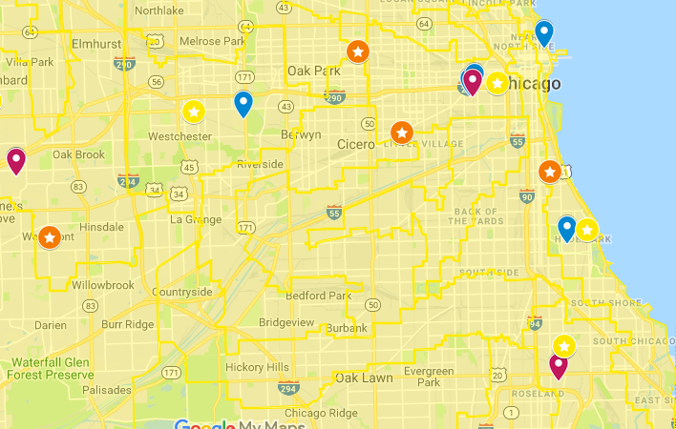
Contact Me
Alan L Hutchison @gmail.com
@alan l hutchison
Google:
alan hutchison uchicago
(Hutch-is-on,
not Hutch-in-son)
(fun fact:
alan hutchinson uchicago
will work too)

